Slide 1
Lower Platte Missouri Tributaries Model
NRD Spring Water Conference
March 4, 2019
Philip Paitz
Water Planning IWM Analyst

Slide 2
Outline
Lower Platte Missouri Tributaries (LPMT) Model Construction Timeline
LPMT Model Construction Domain and Boundaries
Discussion of Model Packages
Calibration and Sensitivity Analysis
Results –Missouri Tributary Zones and a Single Zone

Slide 3
Why Was the LPMT Model Constructed?
Provide a regional numerical groundwater model to aid in the study of the impact of pumping on streams in the area
Before the development of the LPMT model there was no regional model encompassing the eastern region of Nebraska. The LPMT model covers the northern and central part of that region
Region contains complex hydrogeologic features which range from the High Plains Aquifer in the western side, to alluvial aquifers near the major streams, and local perched and semi-perched aquifers in regions containing glacial till

Slide 4
LPMT Model Construction Timeline
Three HDR reports from 2012, 2013, and 2014 provided the basis for the development of the model
Initial model work started in July of 2014. Model development was contracted out to HDR
First version of the model was finished late 2016 and was reviewed by Olsson Associates. Revisions requested included separating the evapotranspiration from the watershed model to an EVT package, incorporating pilot points, and modifing the zonation constraints
Final model incorporating revisions from the review was finished December of 2018

Slide 5
LPMT Model Construction Domain and Boundaries
Layers
Model contains two layers where Layer 1 represents the principle aquifer and Layer 2 represents various bedrock aquifer units
Grid
Consists of 350 Rows and 282 Columns
½ Mile by ½ Mile cells
64,347 active cells in Layer 1
69,168 active cells in Layer 2
Stress Periods – January 1960 through December 2013
1 Steady State, 26 Transient Annual, 336 Transient Monthly
Packages
Well, Recharge, Stream Flow Routing, River, and Evapotranspiration

Slide 6
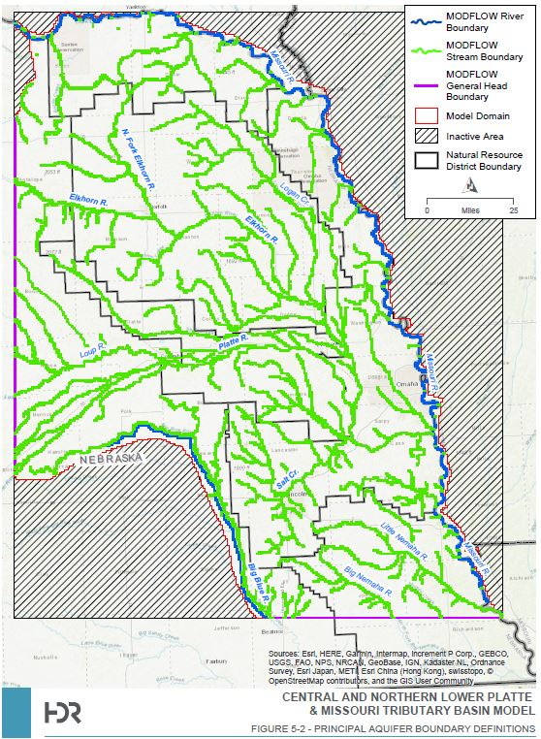
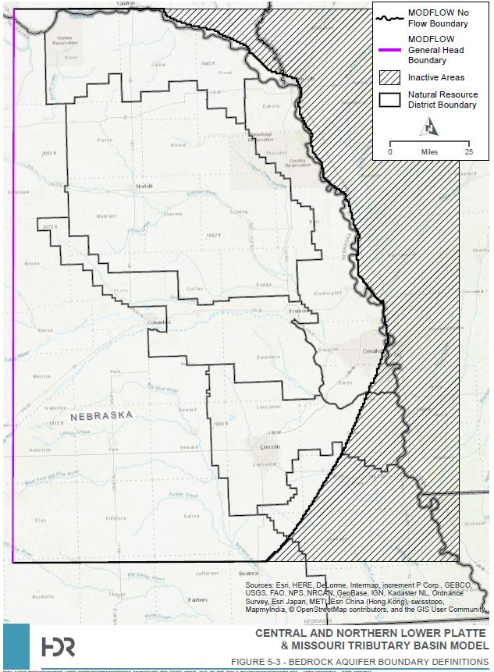
LPMT Model Construction Domain and Boundaries

Slide 7
Streams
Represented internally by the Stream Flow Routing Package (SFR)
Cells containing perennial streams were selected to be stream cells
Baseflow of streams entering the model domain were calculated at gaging stations to aid water budget
SFR allows for stream drying and rewetting as well as creating a water budget term for calculating aquifer/stream exchange

Slide 8
Streams

Slide 9
Watershed Model Outputs
Four major components to the Watershed Model
Climate model
Uses precipitation, temperature, and reference ET to generate inputs for the regionalized soil water balance model
Soil water balance model – CROPSIM
Uses climate model data, soil data, and cropping information to generate the net irrigation requirement
Spatial and temporal distribution of CROPSIM results
Regionalized soil water balance model
Develops recharge and pumping estimates based on CROPSIM results
Output Well and Recharge packages for the groundwater model

Slide 10
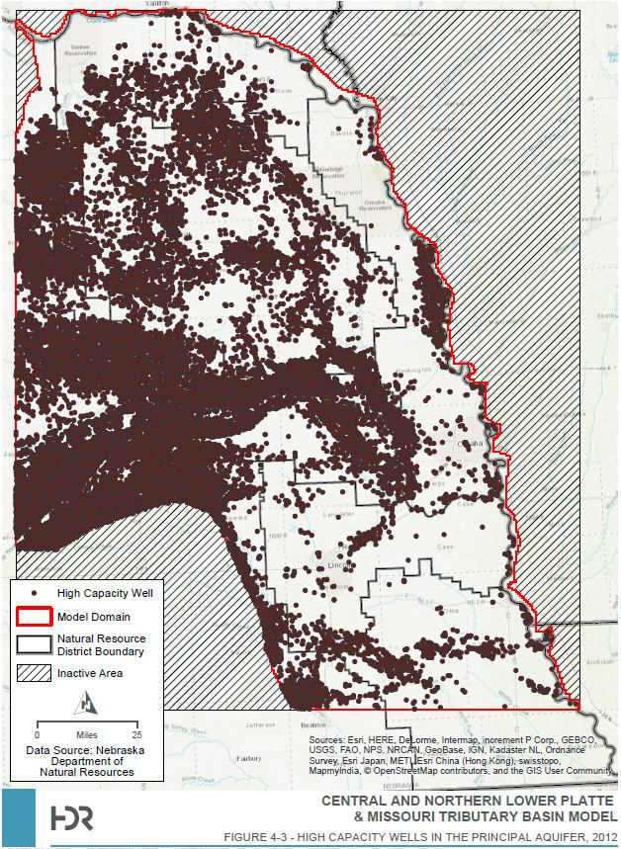
Watershed Model Outputs - Wells

Slide 11
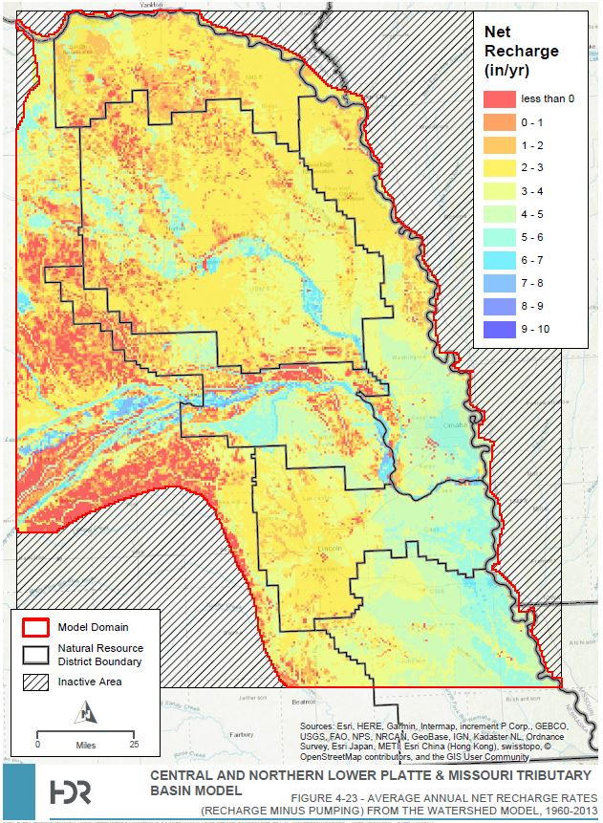
Watershed Model Outputs - Recharge

Slide 12
Evapotranspiration
Added to the model post-review
EVT is represented in areas where the water table is near the surface
Uniform extinction depth of 7 feet was used
Maximum ET rate of 40 in/yr, which was reduced by the average dryland pasture ET to account for water being taken out by the watershed model

Slide 13
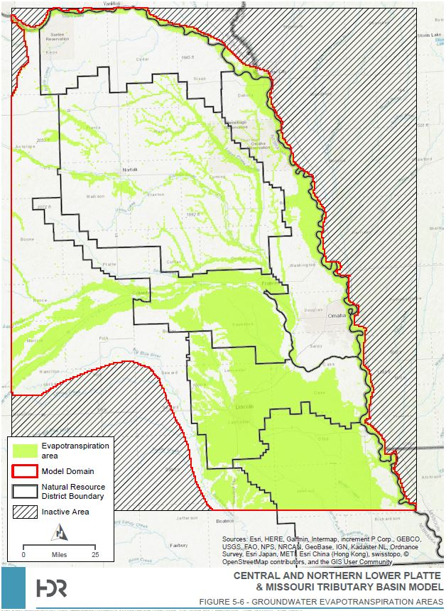
Evapotranspiration - EVT

Slide 14
Hydrogeologic Parameters
Hydraulic Conductivity
Derived from inverse parameter estimation utilizing pilot points and K zones
Calculated with 26 conductivity zones and 309 pilot points
K Zones based on test-hole data, well data, aquifer absent areas, glacial till regions, and the 30 meter USGS DEM
Storage
Layer 1 represented by unconfined specific yield term (0.15)
Layer 2 represented by a confined specific storage term (0.01)
Leakance
Effective vertical hydraulic conductivity between the model layers
Calculated through inverse parameter estimation similar to hydraulic conductivity. Three zones were used

Slide 15
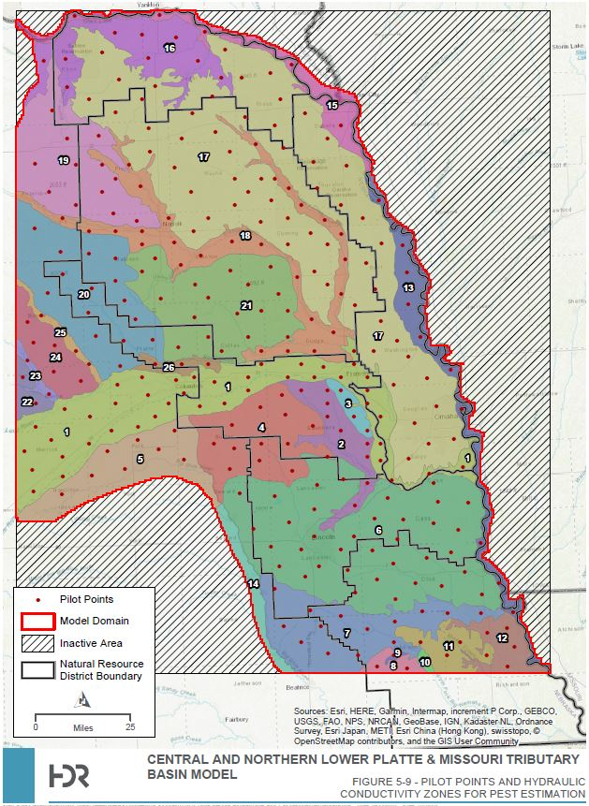
Hydraulic Conductivity

Slide 16
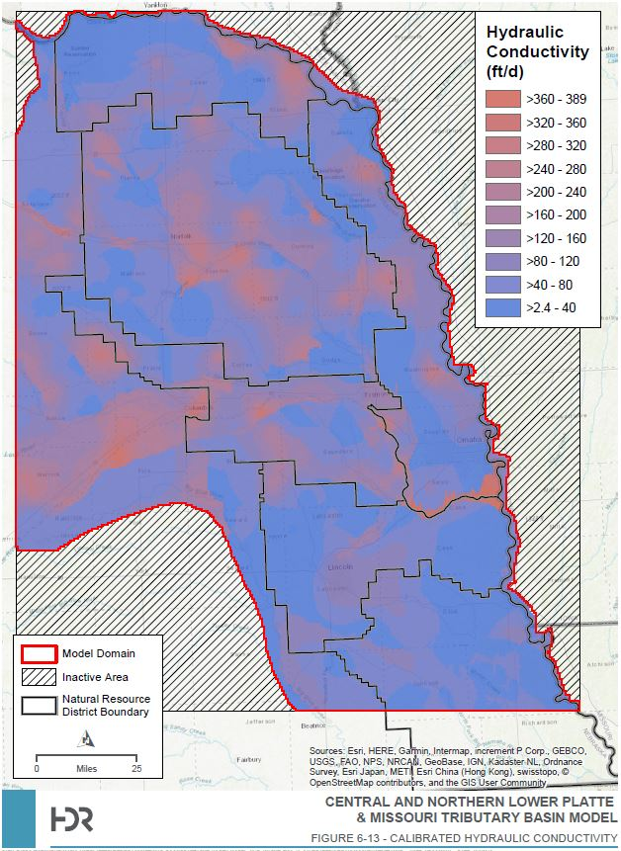
Hydraulic Conductivity

Slide 17
Calibration
Calibration Targets
Groundwater Levels
Stream Baseflow
Synoptic Seepage
Calibration Parameters
Recharge
Hydraulic Conductivity
Storage
Leakance
Water Budget

Slide 18
Groundwater Levels
Set of 1080 wells containing 83,575 measurements were used to represent the calibration period
Only wells spanning at least 10 years worth of data and 10 measurements during the calibration period were used
June, July, and August measurements were removed to limit impact from pumping
Only one monitoring well per cell was used to limit bias
2010 potentiometric surface was used as a target

Slide 19
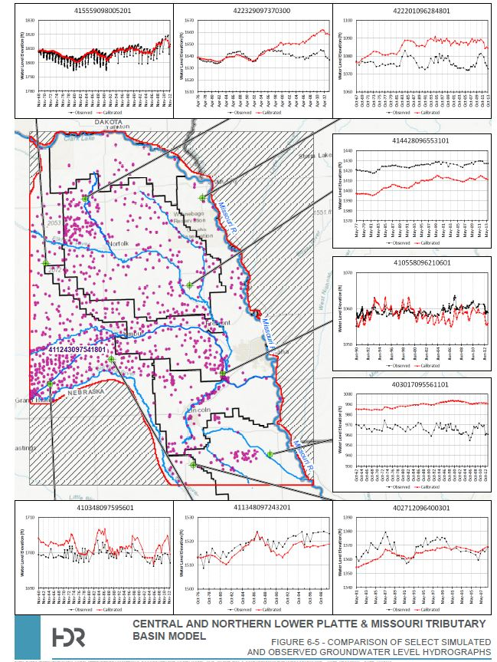
Groundwater Levels

Slide 20
Stream Baseflow
40 streamflow gaging stations were chosen as calibration targets
Baseflow separation was conducted on the daily total streamflow hydrographs as the groundwater model can only simulate baseflow
The reach gains of the streams throughout the model helped in understanding how baseflow was being generated by the model

Slide 21
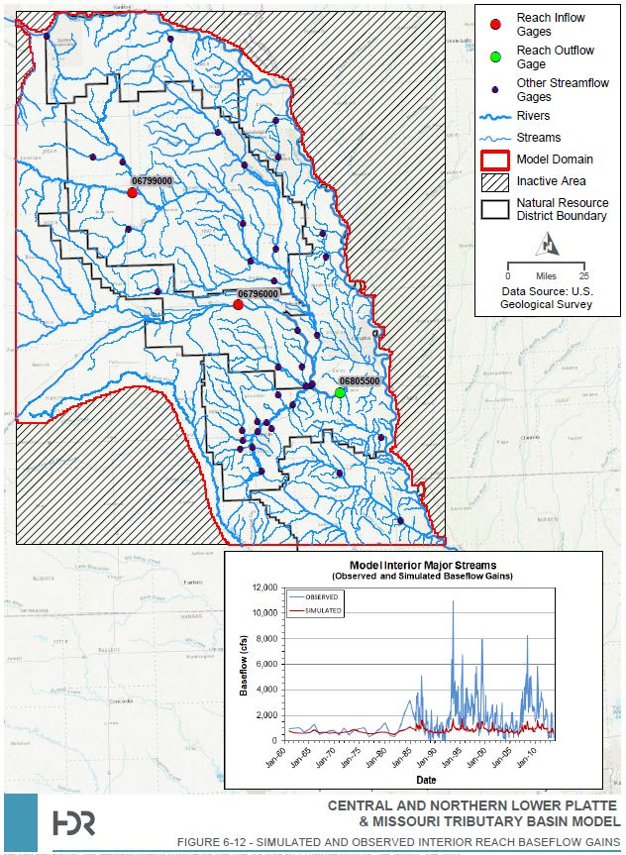
Stream Baseflow

Slide 22
Synoptic Seepage
A survey of 90 known or suspected seepage locations was conducted by NeDNR in October 2014
Goal was to identify seepage areas
Used to see if the groundwater model could reproduce them
67 of the sites visited were noted as “wet”
Model was able to replicate 27
Some of the suspected sites were dubious as there had been recent rainfall event prior to the site visit
Ponding
Overland flow

Slide 23
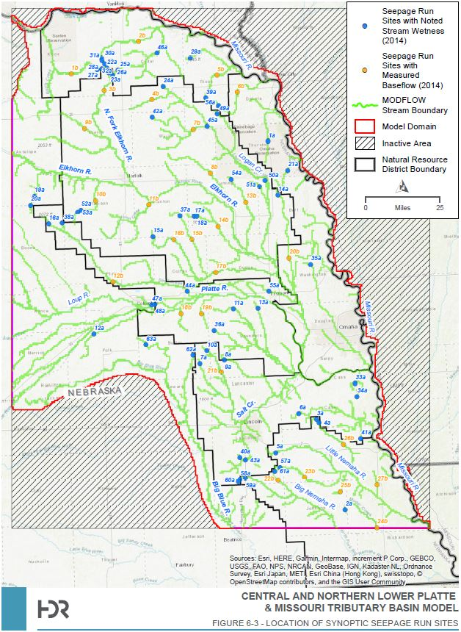
Synoptic Seepage

Slide 24
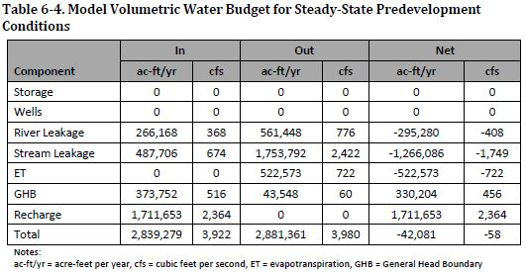
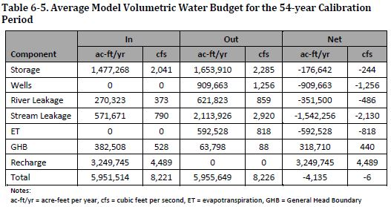
Water Budget

Slide 25
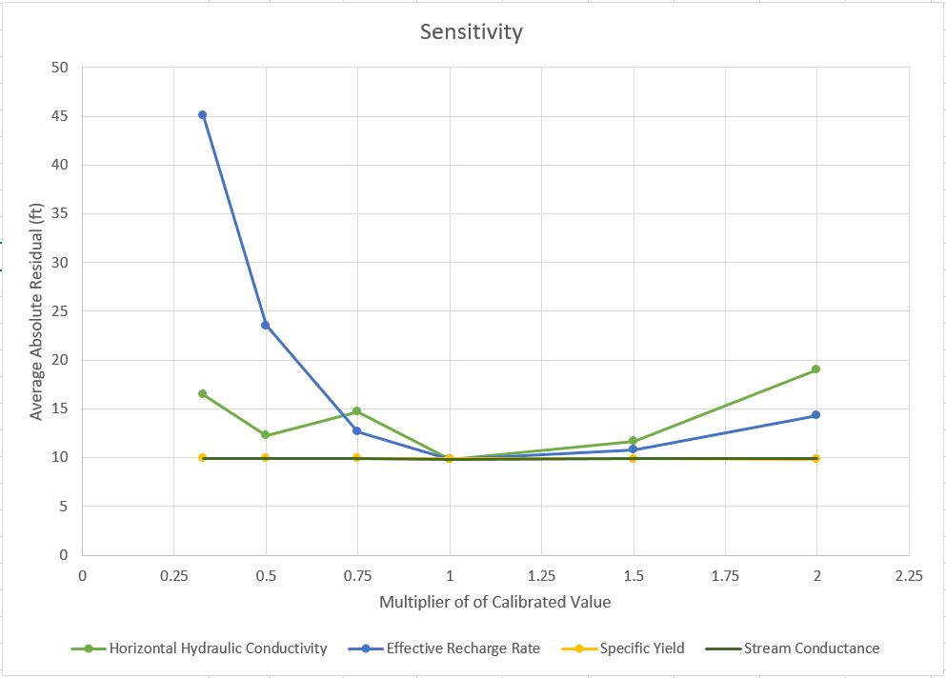
Sensitivity Analysis

Slide 26
The LPMT Model in Use
The Lower Platte Missouri Tributaries Model is now being used within the department to determine the hydrologically connected areas within the region
Currently being incorporated into SUSTAIN and the CIR calculator
In partnership with the NRDs, there are currently two pilot projects underway
Examine and incorporate AEM data into the LPMT Model
Develop local sub-models

Slide 27
LPMT Cycle Well Results 1
Missouri Tributary Zones

Slide 28
LPMT Cycle Well Results 2
Single Tributary Zone

Slide 29
Summary
LPMT Model was constructed to aid in the study of impact to streams within the region with an emphasis on hydrologic connectivity
Utilizes a Watershed model to simulate pumping and recharge
Model was calibrated to three targets
Groundwater Levels
Stream Baseflow
Synoptic Seepage
Process is underway to determine the hydrologically connected areas within the model

Slide 30
Where Can I Get the LPMT Model?
https://dnr.nebraska.gov/Lower-Platte-Missouri-Tributaries-Groundwater-Model

Slide 31
Philip Paitz
Water Planning IWM Analyst
philip.paitz@nebraska.gov

Slide 32
SUSTAIN and the Lower Platte Missouri Tributaries Model
NRD Spring Water Conference
March 4, 2019
Margeaux Carter
Water Planning IWM Specialist

Slide 33
SUSTAIN: A Water Management Tool
Software tool developed by NeDNR for NRDs and water managers
Improve access to
Regional historical water use data
NeDNR’s hydrologic model outputs
Increase transparency of NeDNR’s
Hydrologic modeling process
Water management project evaluation methods
Increase understanding of
Changing water use patterns
Impacts of water use on regional hydrologic systems

Slide 34
SUSTAIN: A Water Management Tool
A graphical user interface which allows NRDs to:
Access NeDNR data
View groundwater model inputs
Evaluate water management scenarios
Run NeDNR groundwater models
Customize graphs
Export data

Slide 35
SUSTAIN: A Water Management Tool
Access water use data
model-wide data
UNW and LPMT models
1960 - 2010
Includes water use reporting meter data
easily process and display data for education/outreach
export data for more options
Evaluate water management projects
Estimate likely to be similar NeDNR’s official evaluation
Good for tuning project proposal
NeDNR support in development

Slide 36
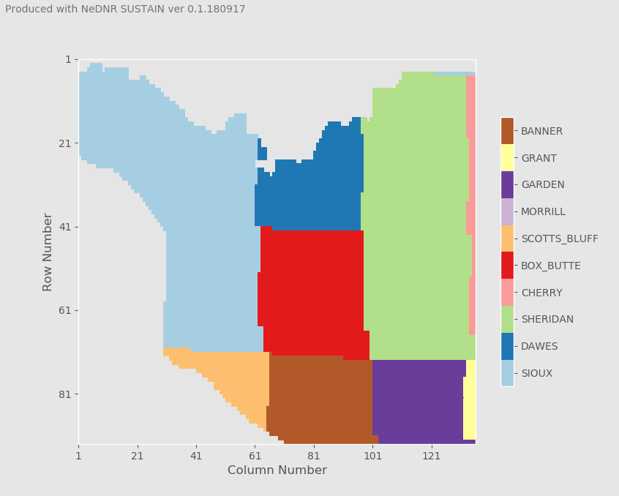
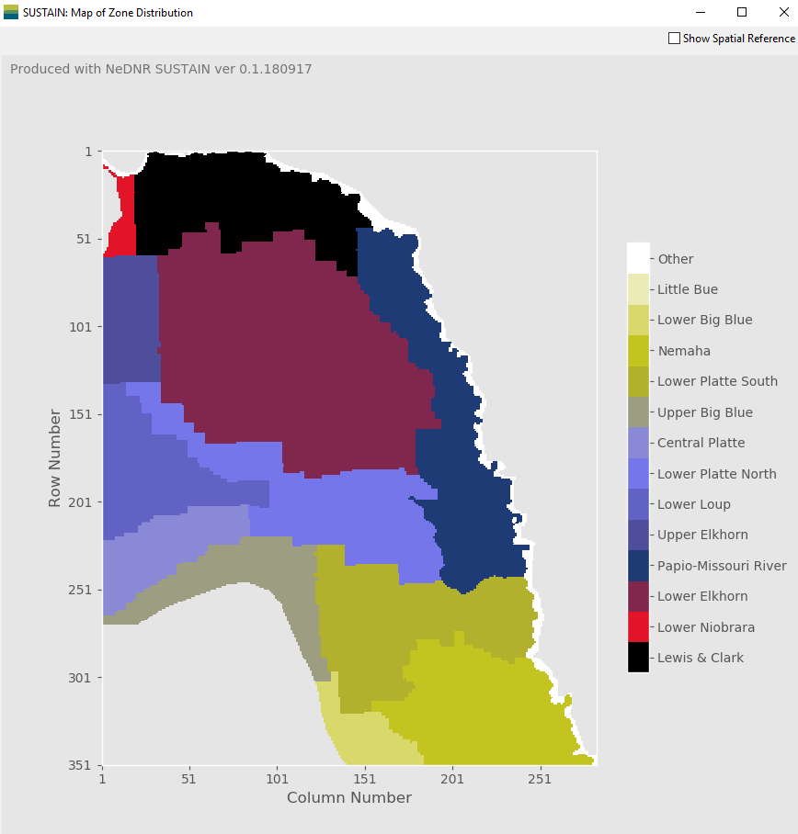
LPMT Model
UNW Model

