Slide 1
Lower Platte Missouri Tributaries Model
Hydrologic Connection Analysis
Lower Platte Basin Tech Committee Meeting
March 4, 2019
Philip Paitz
Water Planning IWM Analyst

Slide 2
Outline
Lower Platte Missouri Tributaries (LPMT) Model Construction Timeline
LPMT Model Construction Domain and Boundaries
Cycle Well Analysis
Cycle Well Zones
Results – All Zones, Missouri Tributary Zones, and a Single Zone

Slide 3
Why Was the LPMT Model Constructed?
Provide a regional numerical groundwater model to aid in the study of the impact of pumping on streams in the area
Before the development of the LPMT model there was no regional model encompassing the eastern region of Nebraska. The LPMT model covers the northern and central part of that region
Region contains complex hydrogeologic features which range from the High Plains Aquifer in the western side, to alluvial aquifers near the major streams, and local perched and semi-perched aquifers in regions containing glacial till

Slide 4
LPMT Model Construction Timeline
Three HDR reports from 2012, 2013, and 2014 provided the basis for the development of the model
Initial model work started in July of 2014. Model development was contracted out to HDR
First version of the model was finished late 2016 and was reviewed by Olsson Associates. Revisions requested included separating the evapotranspiration from the watershed model to an EVT package, incorporating pilot points, and modify the zonation constraints
Final model incorporating revisions from the review was finished December of 2018

Slide 5
LPMT Model Construction Domain and Boundaries
Layers
Model contains two layers where Layer 1 represents the principle aquifer and Layer 2 represents various bedrock aquifer units
Grid
Consists of 350 Rows and 282 Columns of ½ Mile by ½ Mile cells
64,347 active cells in Layer 1
69,168 active cells in Layer 2
Stress Periods – January 1960 through December 2013
1 Steady State, 26 Transient Annual, 336 Transient Monthly
Packages
Well, Recharge, Stream Flow Routing, River, and Evapotranspiration

Slide 6
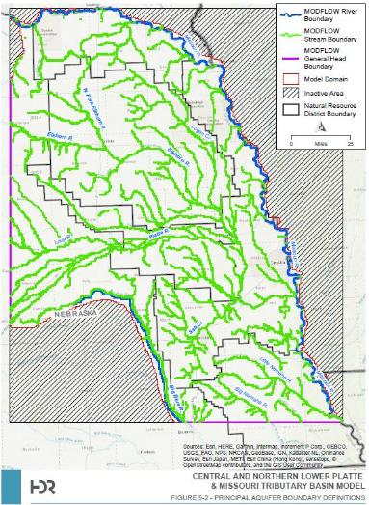
LPMT Model Construction Domain and Boundaries

Slide 7
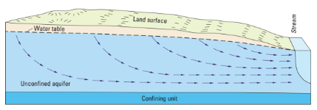
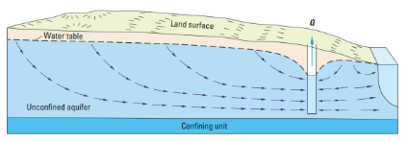
Cycle Well Analysis
Natural Condition
Capture
Induced Infiltration

Slide 8
Cycle Well Analysis
In order to calculate Stream Depletion Factors a cycle of pumping of a known, fixed quantity for every stress period by a fictional well is needed
This process is repeated for every cell in a model’s active domain
$Q_{s}^{′}$ is the cumulative stream leakage after the new well
$Q_{s}$ is the cumulative stream leakage of the baseline
$Q_{w}$is the total pumping from the new well
$$SDF=\frac{Q_{s}^{′}−Q_{s}}{Q_{w}}$$

Slide 9
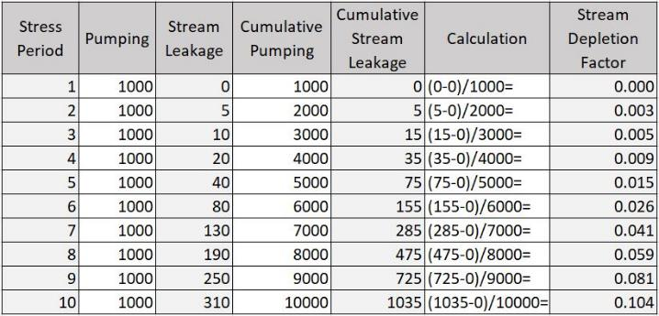
Cycle Well Analysis
$Q_{s}^{′}$ is the cumulative stream leakage after the new well
$Q_{s}$ is the cumulative stream leakage of the baseline
$Q_{w}$is the total pumping from the new well
$$SDF=\frac{Q_{s}^{′}−Q_{s}}{Q_{w}}$$

Slide 10
LPMT Cycle Well Setup
Hydrologic connectivity determined by running a fifty year simulation
LPMT cycle well analysis consists of original models 336 transient monthly stress periods plus the last 132 repeated twice
Original 336 transient periods – Jan 1986 to Dec 2013
Repeated last 127 periods twice - Jan 2002 to Dec 2013
Total of 600 stress period representing fifty years
All model packages were modified to represent the stress period changes

Slide 11
LPMT Cycle Well Zones
Zones were created to aid in the analysis of hydrologically connected areas
The zones are based off of HUC 10 Watershed boundaries and are the same for both layers
Missouri, Blue, Loup, and Platte Tributaries were grouped
Bazille and Elkhorn watersheds without stream cells were grouped
Total of fifty nine zones

Slide 12
LPMT Cycle Well Zones

Slide 13
LPMT Cycle Well Results 1
All Zones

Slide 14
LPMT Cycle Well Results 2
Missouri Tributary Zones

Slide 15
LPMT Cycle Well Results 3
Single Tributary Zone

Slide 16
What’s Left to Do?
Finish post-processing the cycle well results
QAQC the process, post-processing, and results
Export results to shapefiles and create final csv files for each zone
Finalize documentation and write metadata for shapefiles
Distribute results to public
Also ahead with the NRD’s help
Examine and incorporate AEM data into the LPMT Model
Develop local sub-models

Slide 17
Summary
LPMT Model was constructed to aid in the study of impact to streams within the region with an emphasis on hydrologic connectivity
Cycle well analysis was conducted using the LPMT Model expanded to fifty years
Zones allow for hydrologic connectivity to analyzed at watershed level
Post-processing and QAQC need to be completed

Slide 18
Philip Paitz
Water Planning IWM Analyst
philip.paitz@nebraska.gov

