Slide 1
How July 16th, 2004
Changed Nebraska’s Water Management
2024 NRD Water Programs Conference
March 5, 2024
Jesse Bradley, Deputy Director

Slide 2
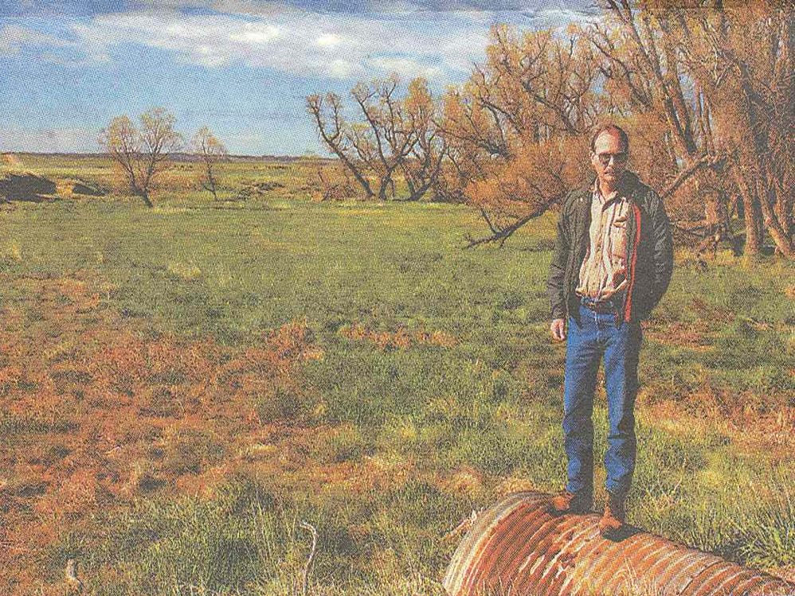
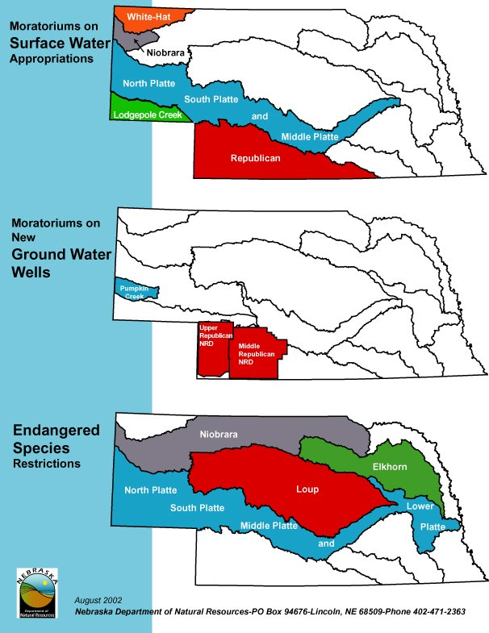
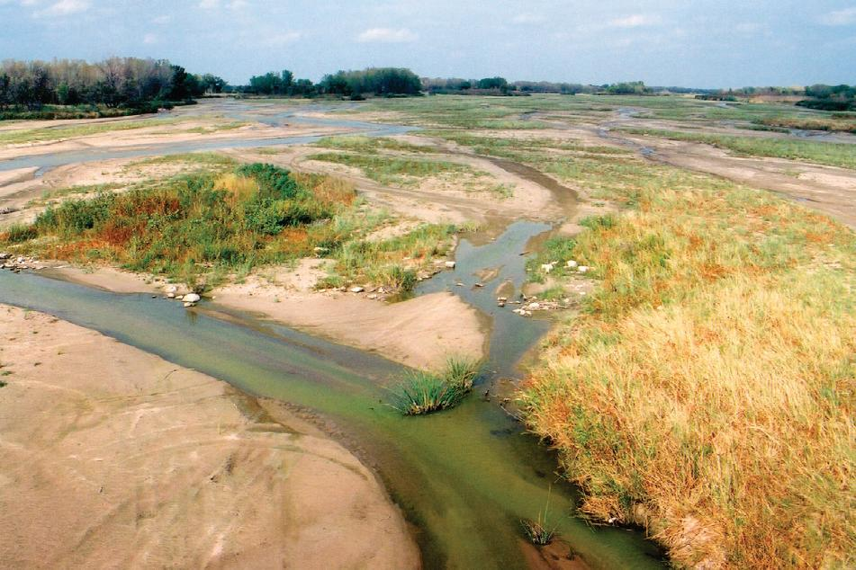
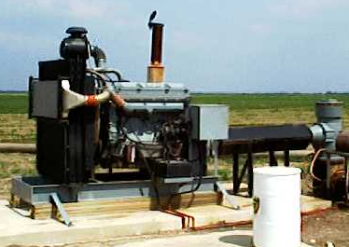
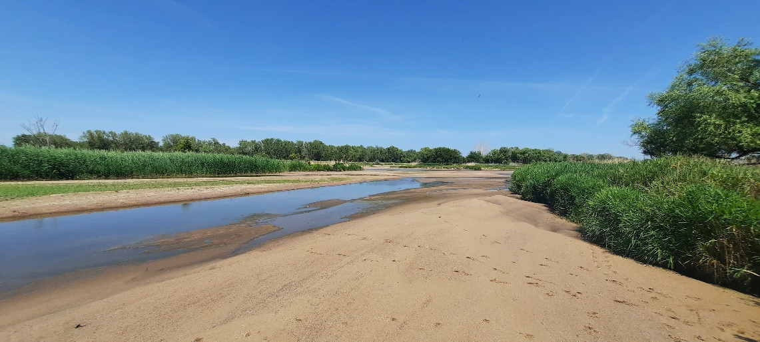
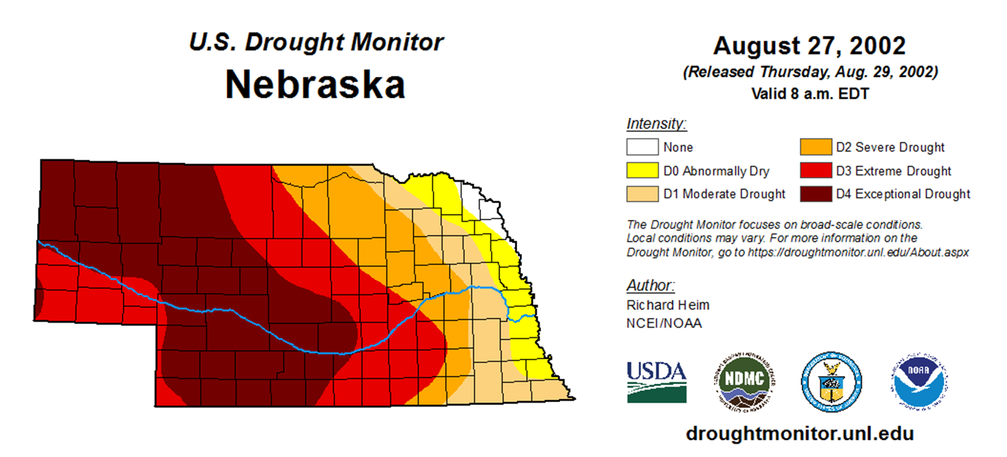
Pre-LB 962 Conditions
Lawsuits
CNPPID vs. NeDNR
Spear T. vs. Knaub
Spear T. vs. NeDNR
Nebraska vs. Wyoming
Kansas vs. Nebraska
Prolonged Drought
As of August 2002
Reactionary, Limited Ability to Respond

Slide 3
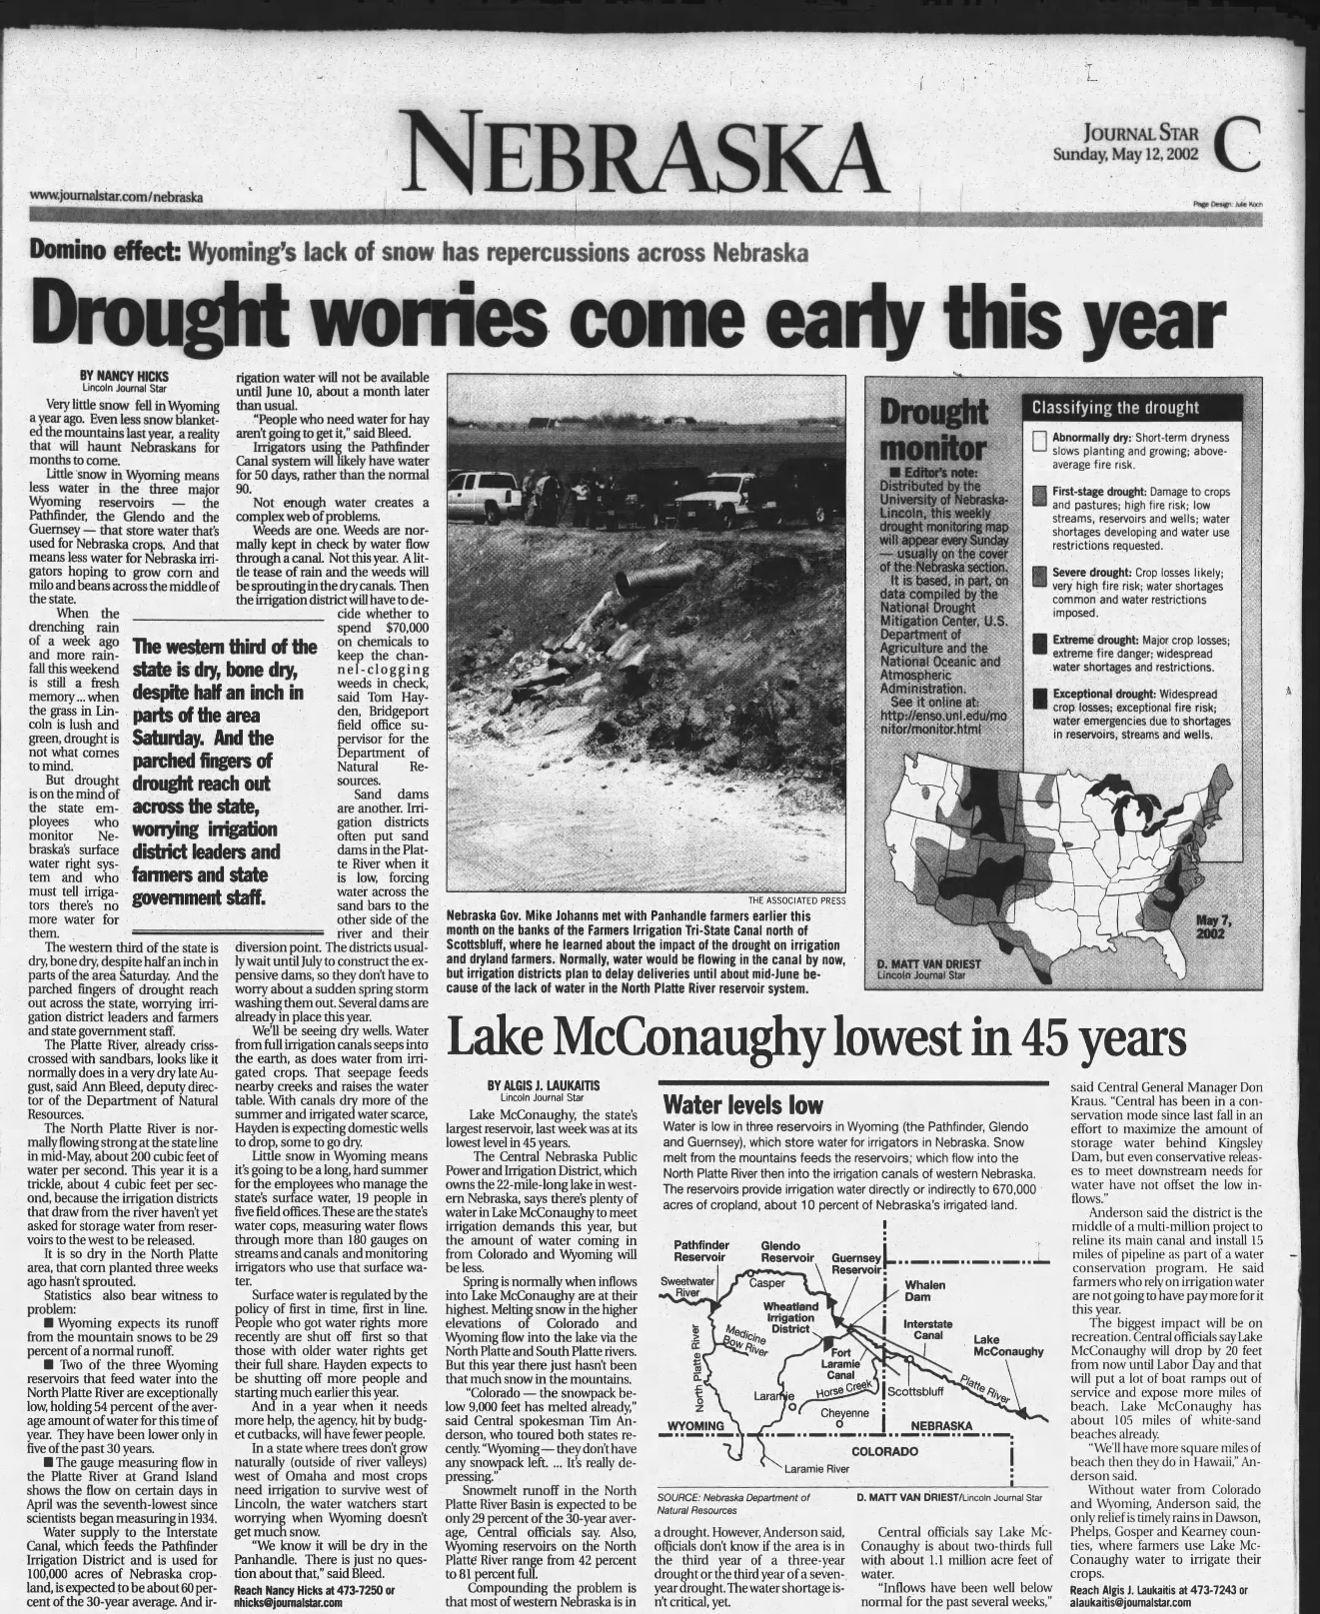
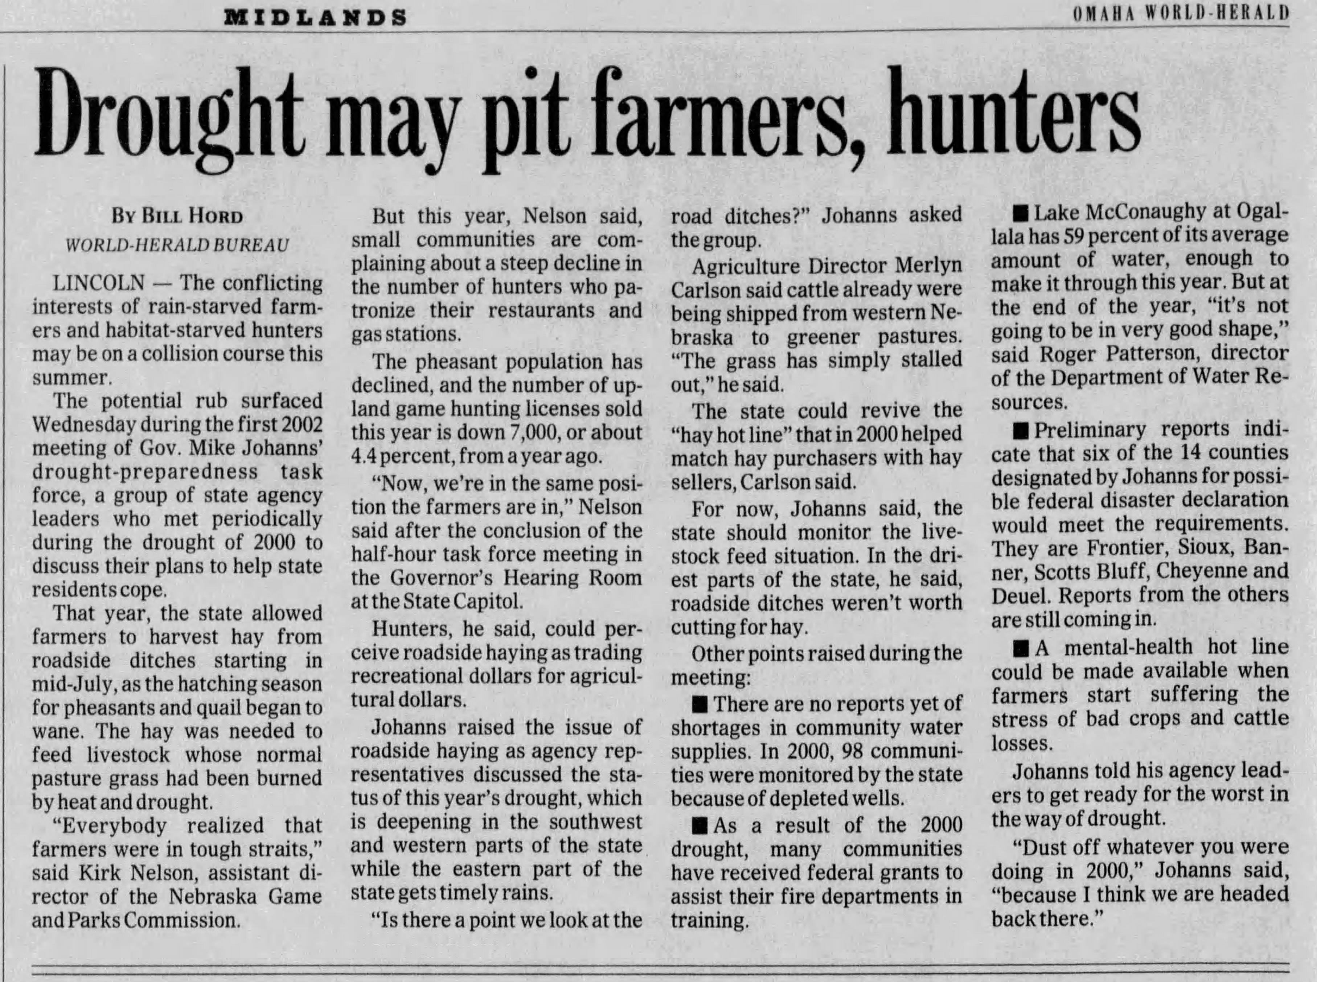
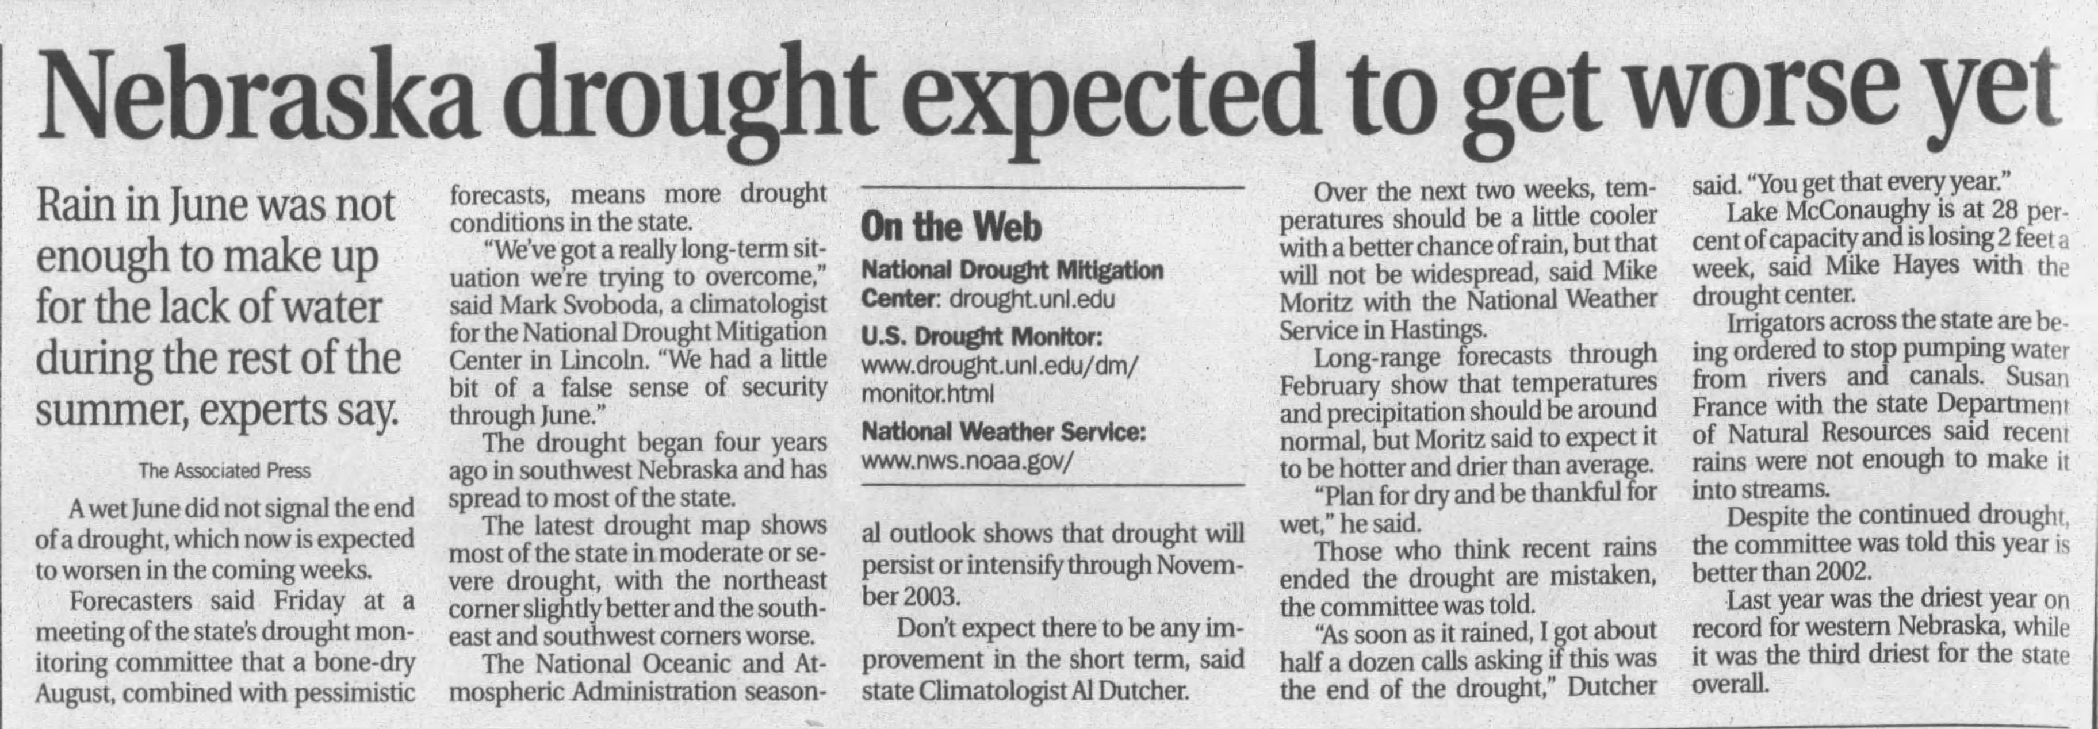
Pre-LB 962 Conditions
Lawsuits
CNPPID vs. NeDNR
Spear T. vs. Knaub
Spear T. vs. NeDNR
Nebraska vs. Wyoming
Kansas vs. Nebraska
Prolonged Drought
As of August 2002
Reactionary, Limited Ability to Respond

Slide 4
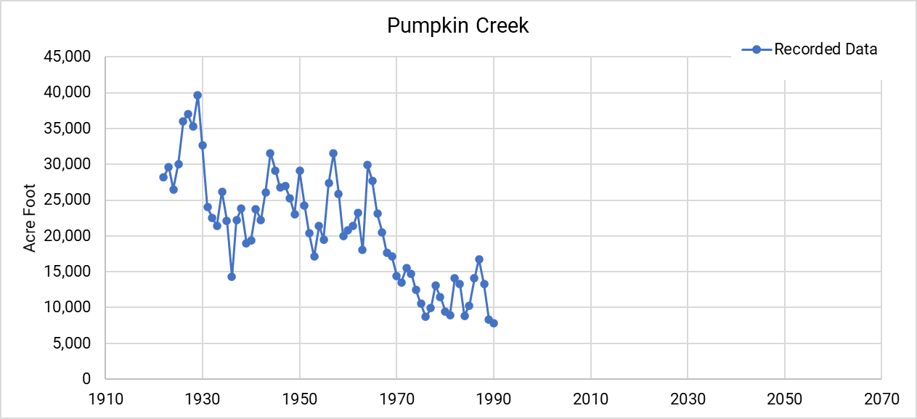
Pumpkin Creek Then…

Slide 5
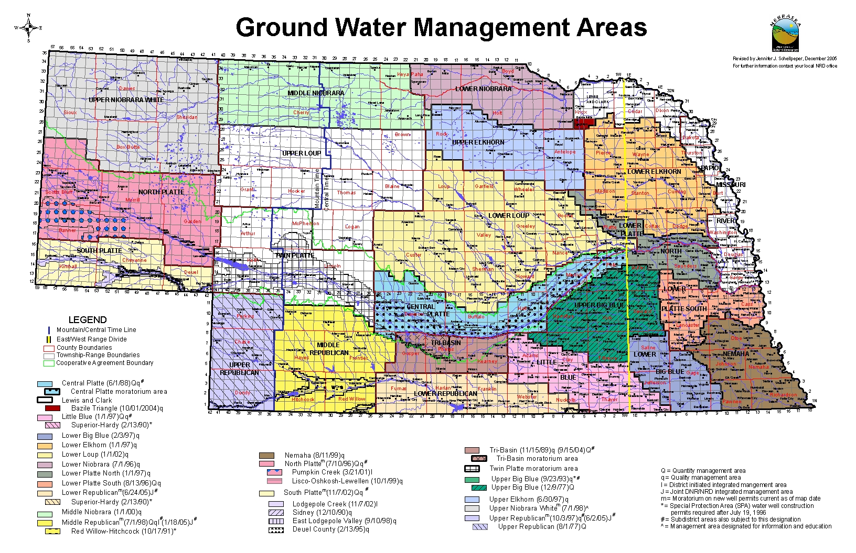
Pre - LB 962 Conditions
Some water planning and management tools
Groundwater Management and Protection Act (1975)
Some planning and control elements
Joint Action Plans
Derived from LB 108 (1996)
Explicitly established hydrologic connection between ground and surface water
In practice, NRDs lacked the authorities and hard deadlines to adequately respond to imbalances between demand and supply

Slide 6
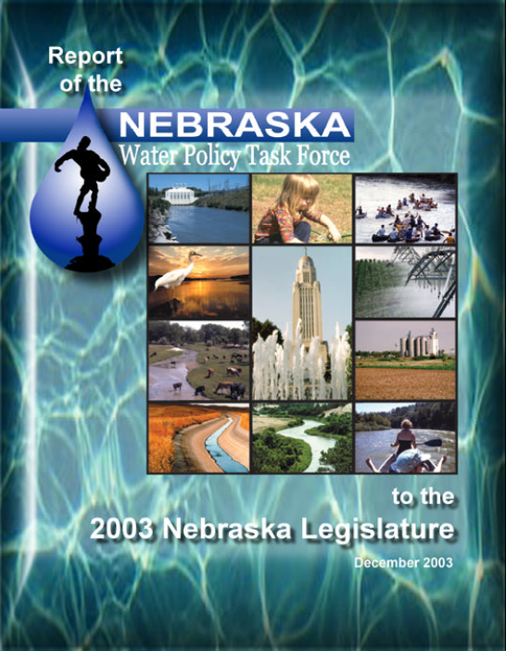
A New Vision
Authorized by LB 1003 in 2002
49 members
Submitted report in December 2003
Recommended a more proactive approach to Integrated Management of Hydrologically Connected Waters
Recommendations embodied in 2004 legislation: LB 962

Slide 7
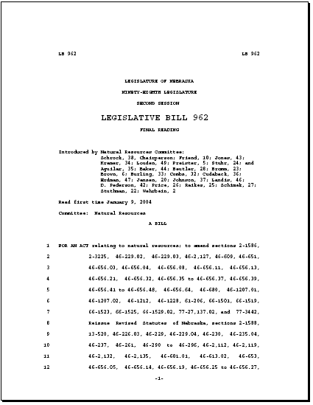
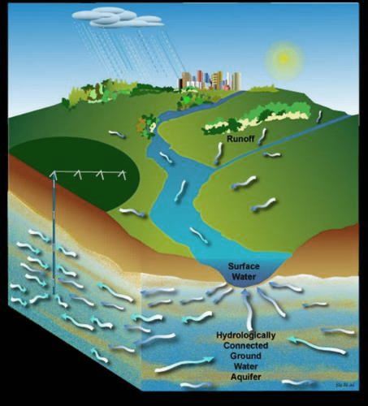
LB 962
Passed Unicameral April 13, 2004, by 44-2-3 vote
Approved by Governor Johanns on April 15, 2004
Effective July 16, 2004
Surface Water
Regulated by NeDNR
Prior appropriations
First in time is first in right
Integrated
water
management
Groundwater
Regulated by NRDs
Correlative rights
Share and share alike

Slide 8
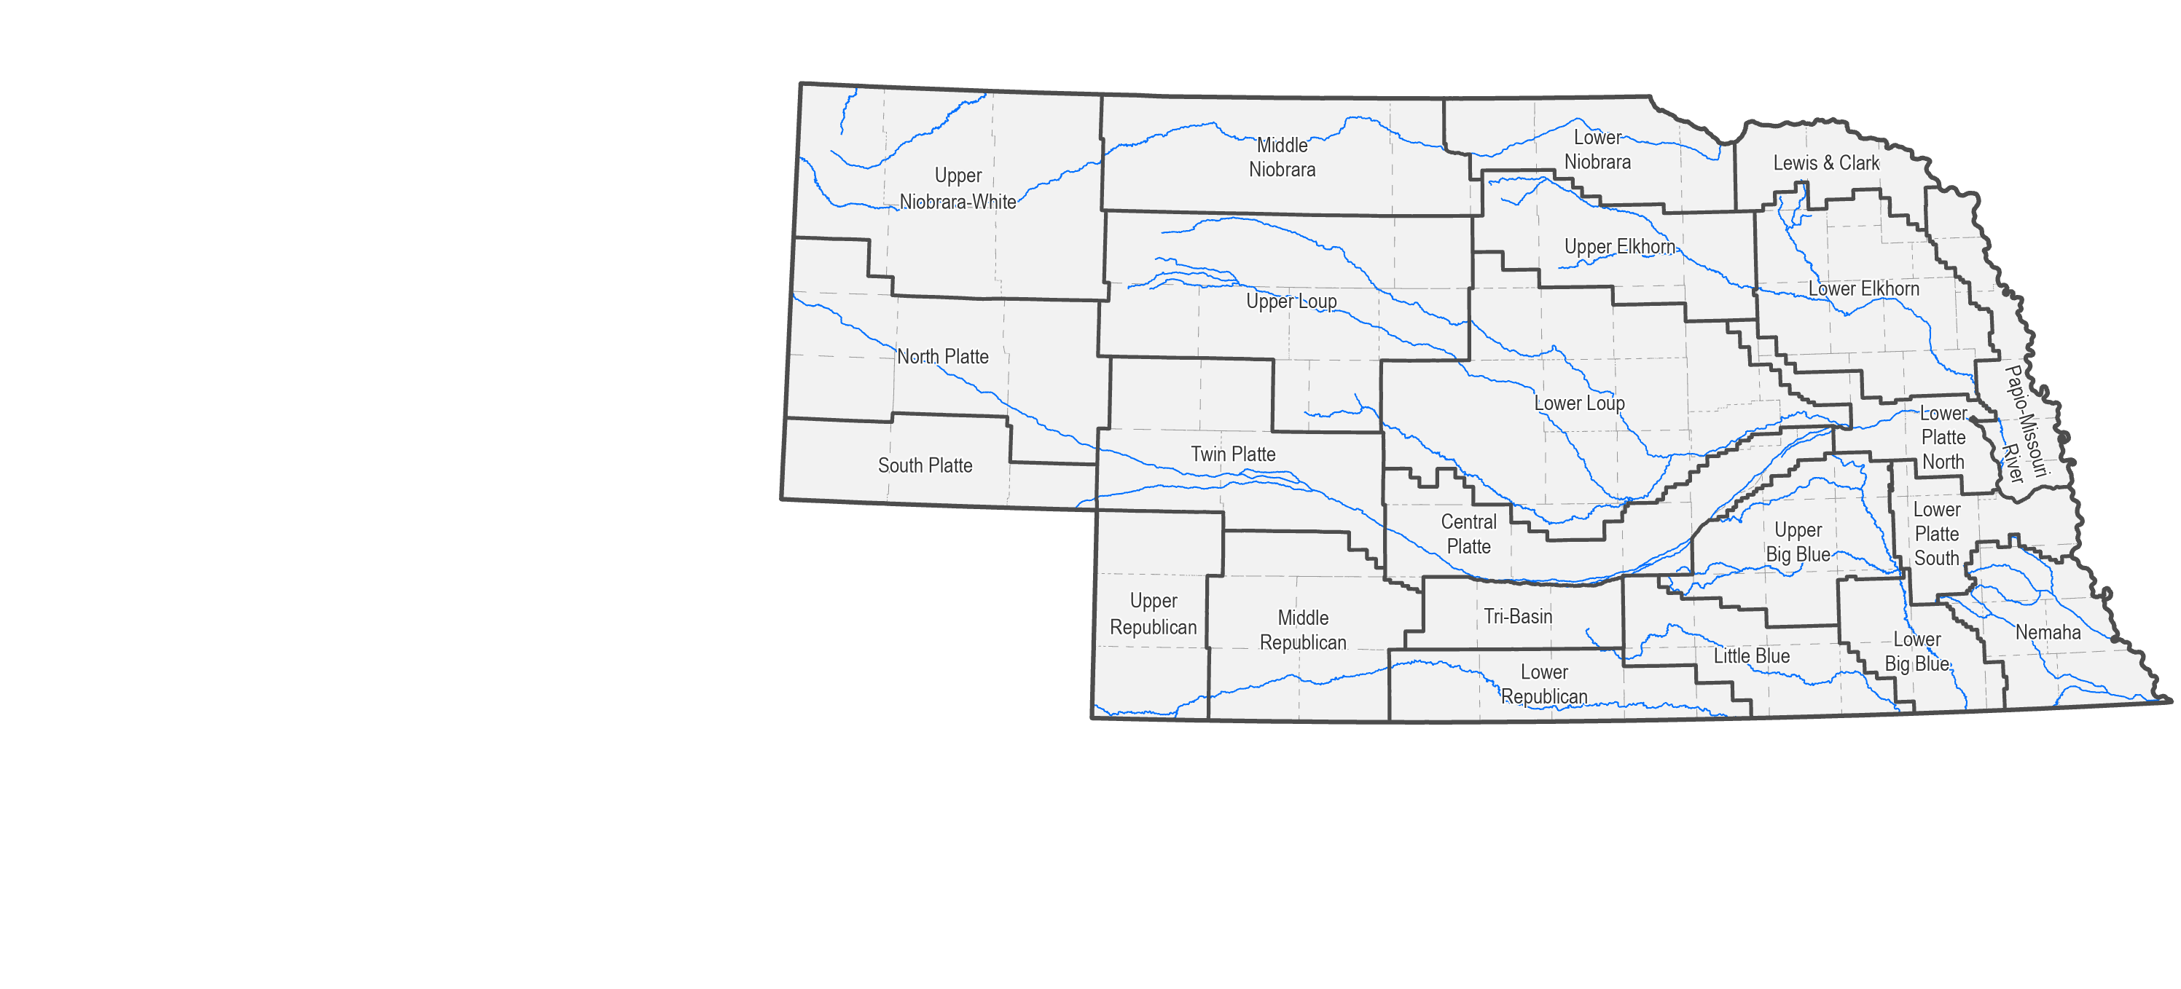
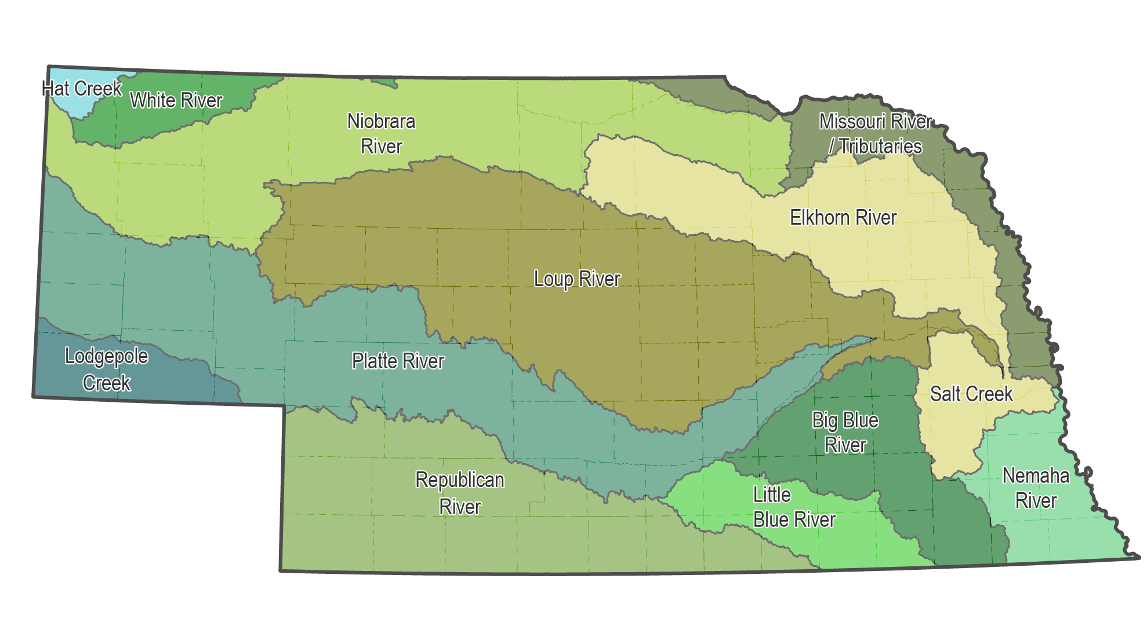
Surface and Groundwater Management Boundaries

Slide 9
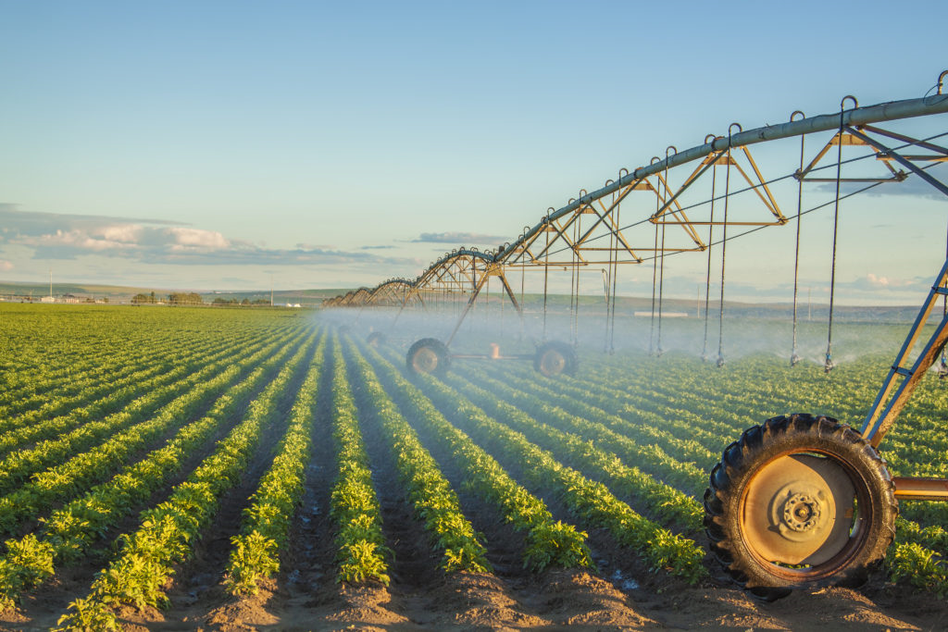
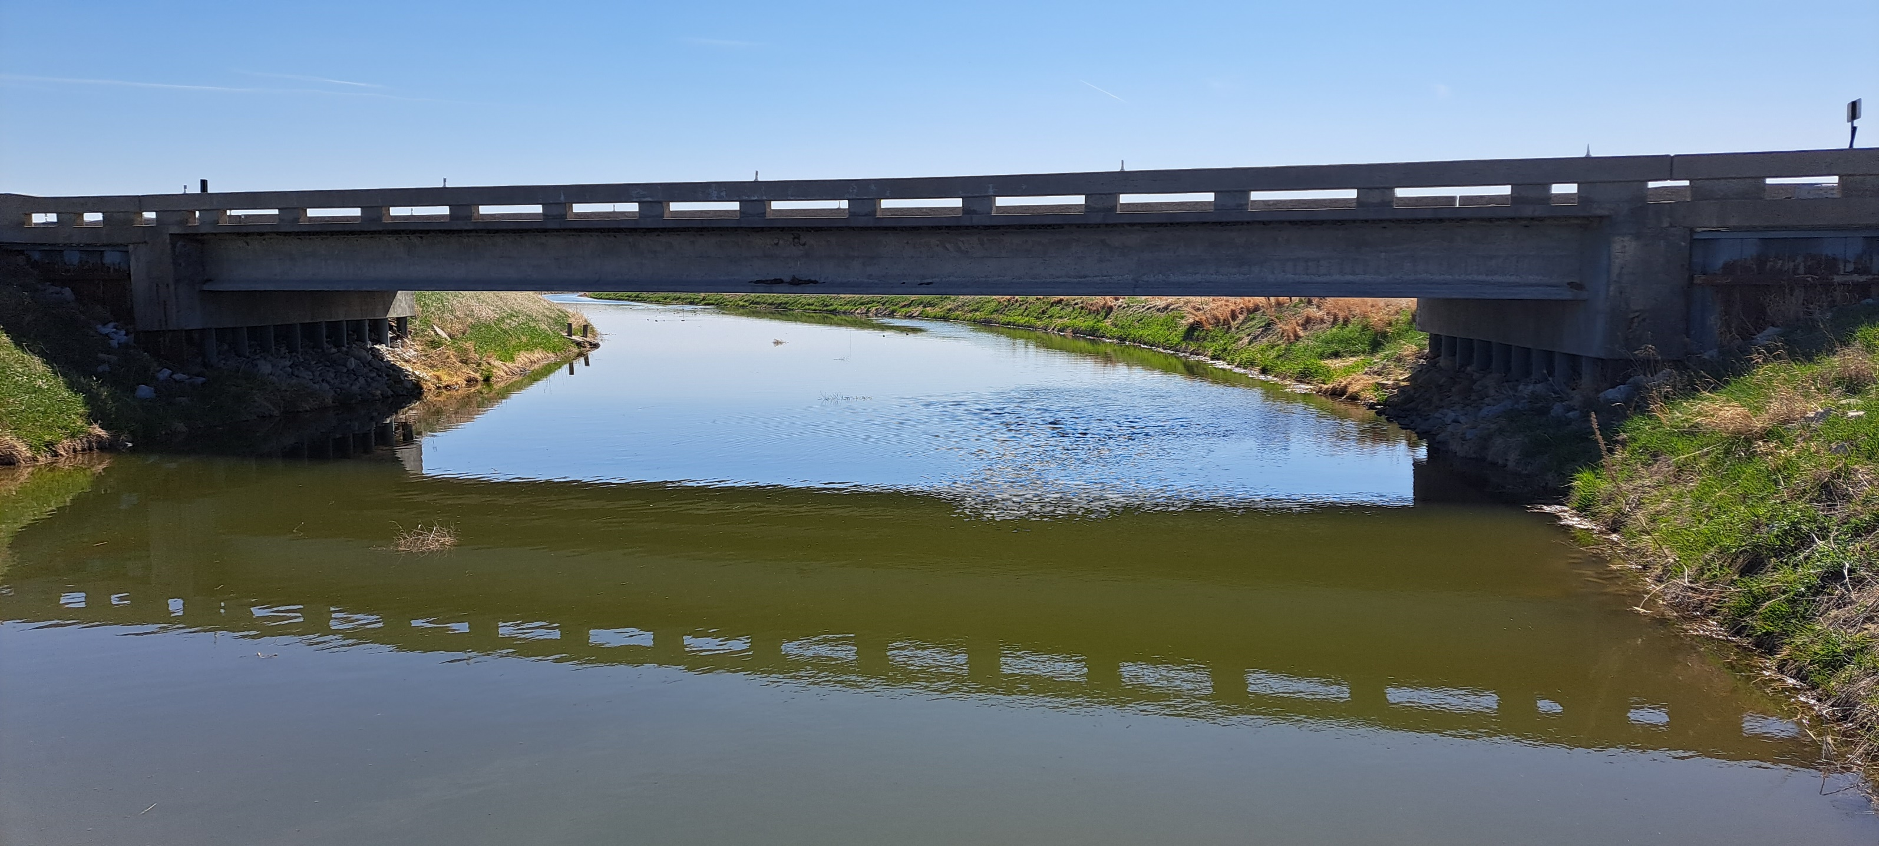
LB 962
Provides new tools and controls for surface water
Provided new tools and controls for groundwater
Developed a process for Integrated Management Plans:
Goals and objectives to sustain a balance between water uses and water supplies for all hydrologically connected waters
Map showing extent of the area subject to IMP
One or more groundwater controls
One or more surface water controls
May include incentive programs

Slide 10
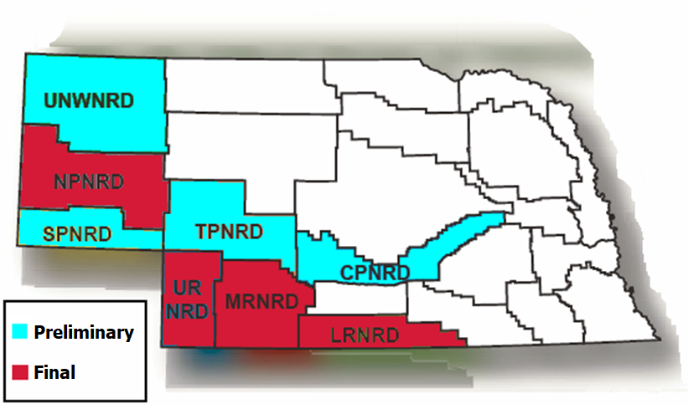
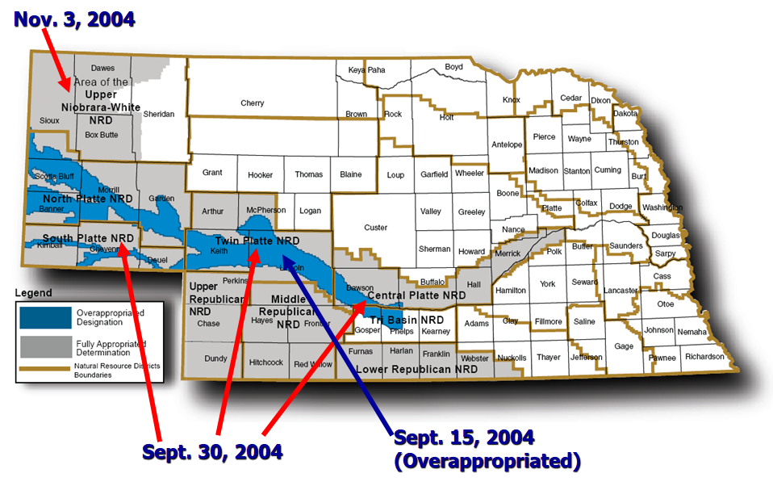
LB 962
Fully Appropriated Designations, July 16, 2004
Fully and Overappropriated Designations, Final

Slide 11
Early Days of Implementation

Slide 12
Early Implementation Issues
Discussions over State vs. NRD obligations and authorities
Interstate litigation #2 in Republican River Basin
Lack of clear dedicated funding sources
Platte River Recovery and Implementation Program signed (ESA compliance)
Annual Evaluation of Hydrologically Connected Waters (FAB Report)
Municipal and Industrial water supplies

Slide 13
New Laws and Tools Added
2006
LB 1226
Forecast in Republican River Basin, Municipal and Industrial Allocations
2007
LB 701
New NRD funding tools and Water Resources Cash Fund
The Department establishes a dedicated division to support interstate management and integrated management

Slide 14
Middle Period of Implementation

Slide 15
Middle Period of Implementation
PBHEP and PBC organize funding in Upper Platte
Interstate litigation #2 in full swing, 3rd generation of IMPs
You are Fully Appropriated, No You're Not – Round 1 Lower Platte
You are Fully Appropriated, No You're Not – Round 2 Niobrara
Major projects being implemented
Rock Creek Aug., Conj. Management, NCORPE, etc.

Slide 16
New Laws and Tools Added
2009
LB 483
Reversal rules for new development -2,500 acres
2009
LB 54
Could postpone FAB Evaluation for up to 4 years, economic development must be considered
2010
LB 764
Voluntary IMPs
2014
LB 1098
Water Sustainability Fund
The Department begins working to develop groundwater models statewide

Slide 17
More Recent Period of Implementation

Slide 18
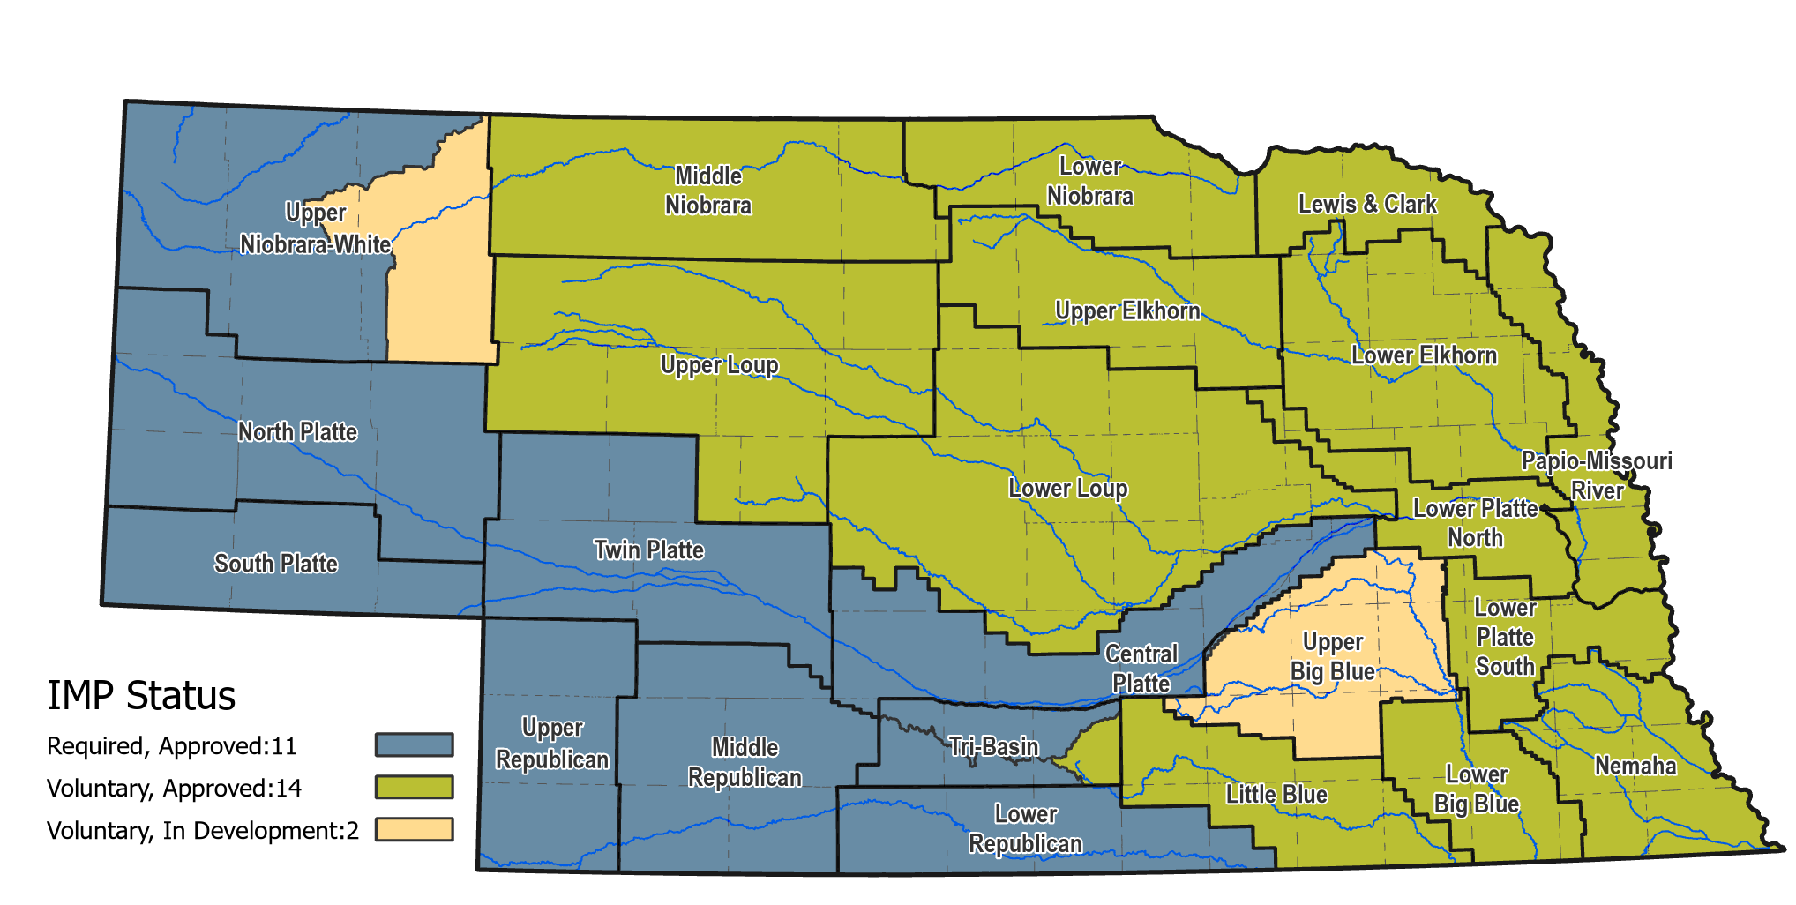
More Recent Period of Implementation
2012
Following Flash Drought - Voluntary Basin-Wide Plan Lower Platte Basin
2014
Republican River litigation completed
2015
Spencer Hydropower Purchase Agreement
2017
All NRDs begin Voluntary IMP Development – most recent full FAB report
2016 - 2018
RRCA Resolutions adopted
2019
PRRIP extended and Upper Platte IMPs extended for a second ten-year increment
Many other great water programs implemented!
Laws Stabilize, Minimal Change!

Slide 19
The Role of Science and Data Collection

Slide 20
Stream Flow and Surface Water Use Monitoring

Slide 21
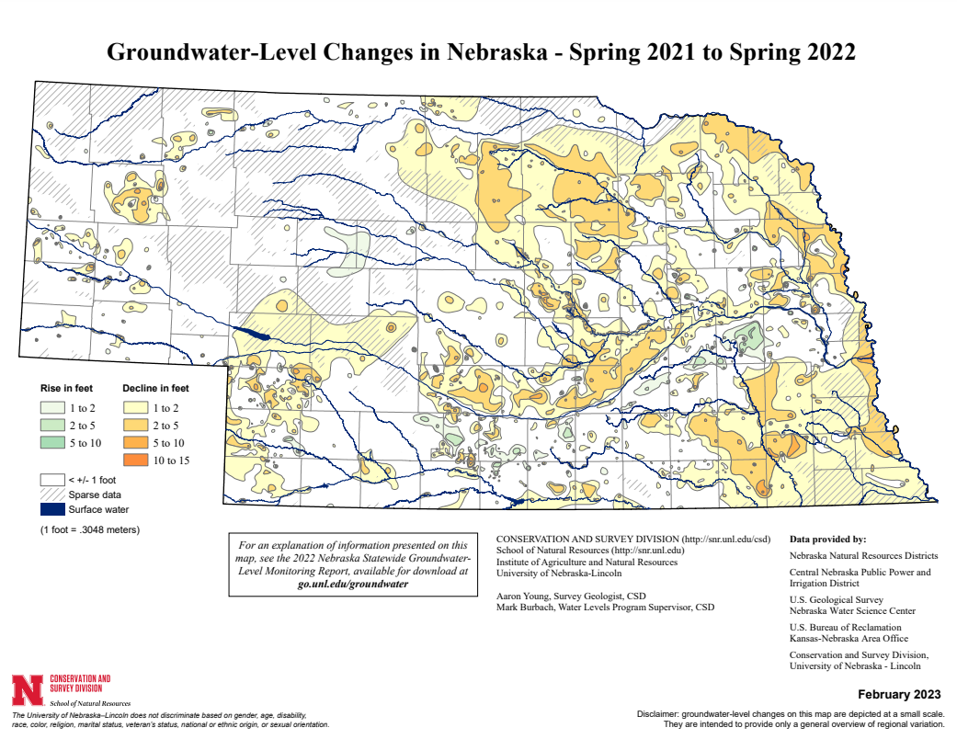
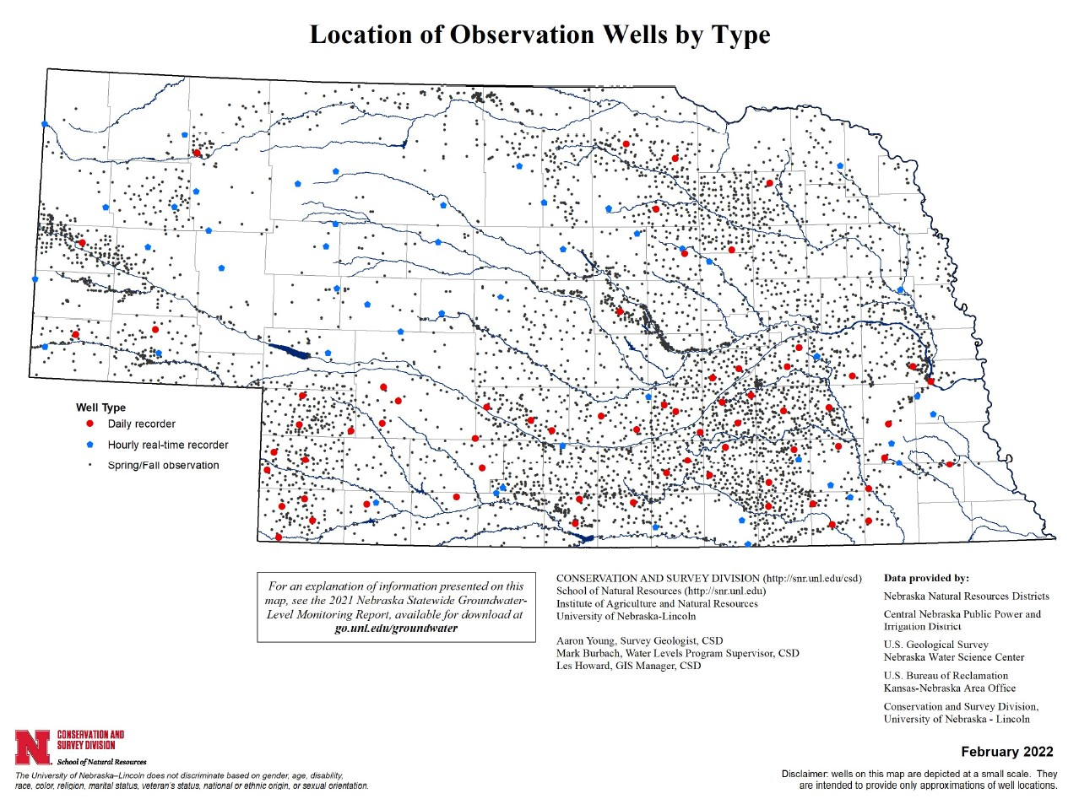
Groundwater Monitoring (NRDs)

Slide 22
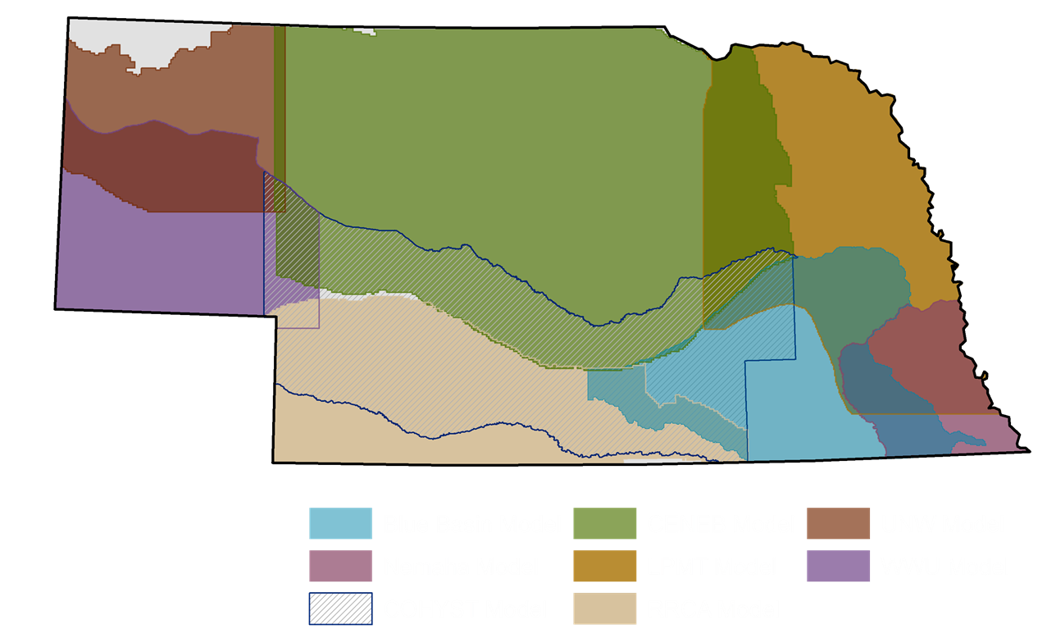
GW Model Areas

Slide 23
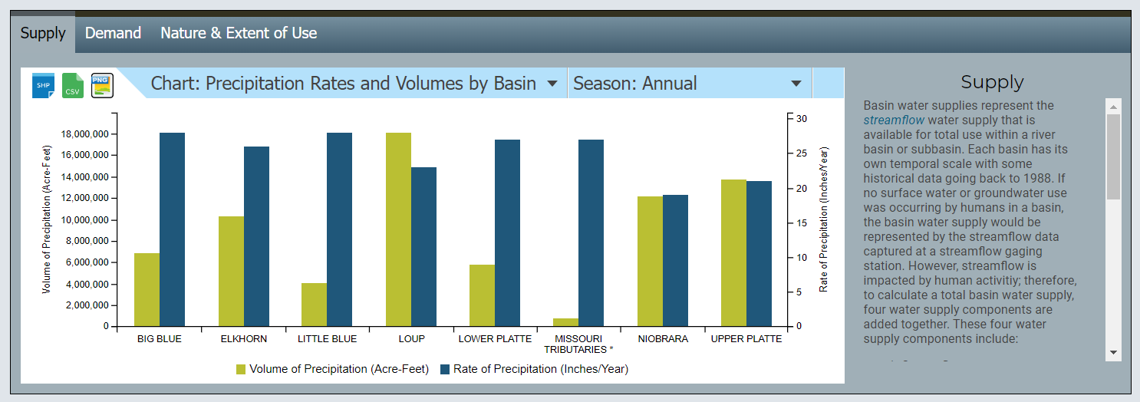
INSIGHT

Slide 24
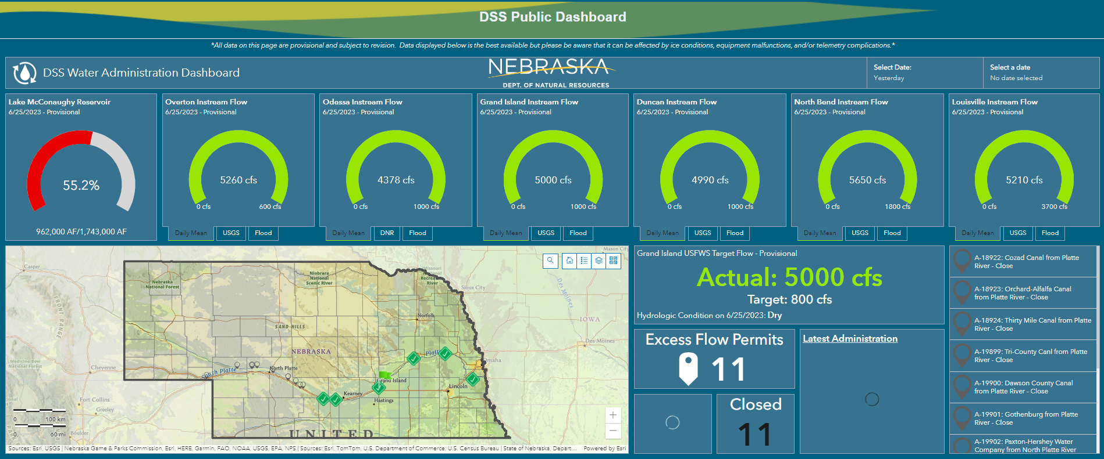
Decision Support Tool

Slide 25
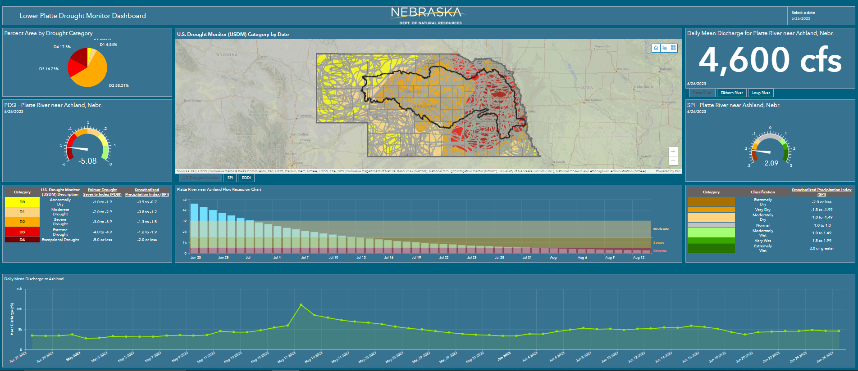
Drought Monitoring

Slide 26
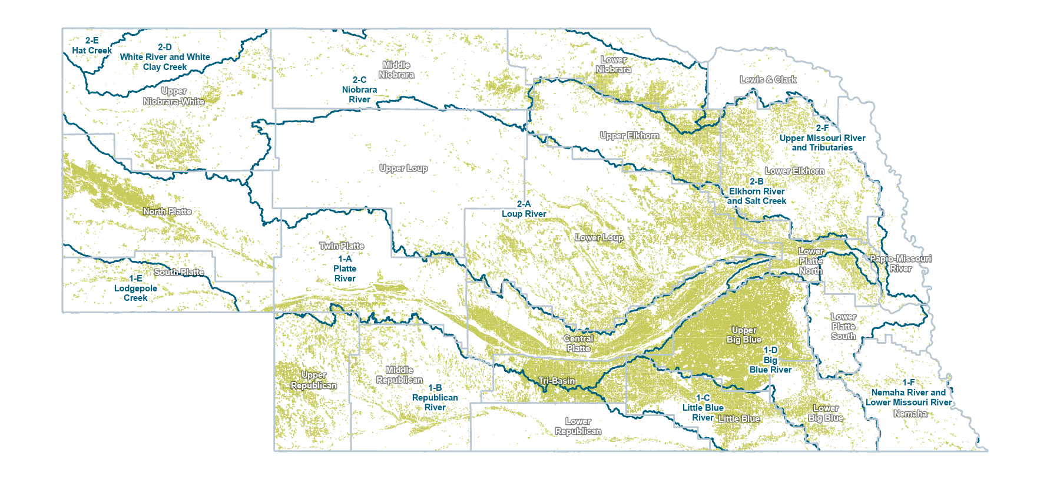
Legally Irrigable Groundwater and Surface Water Parcels
https://gis.ne.gov/portal/apps/webappviewer/index.html?id=ff6099a748e94d83b7960e20505a1453
June 28th, 2023

Slide 27
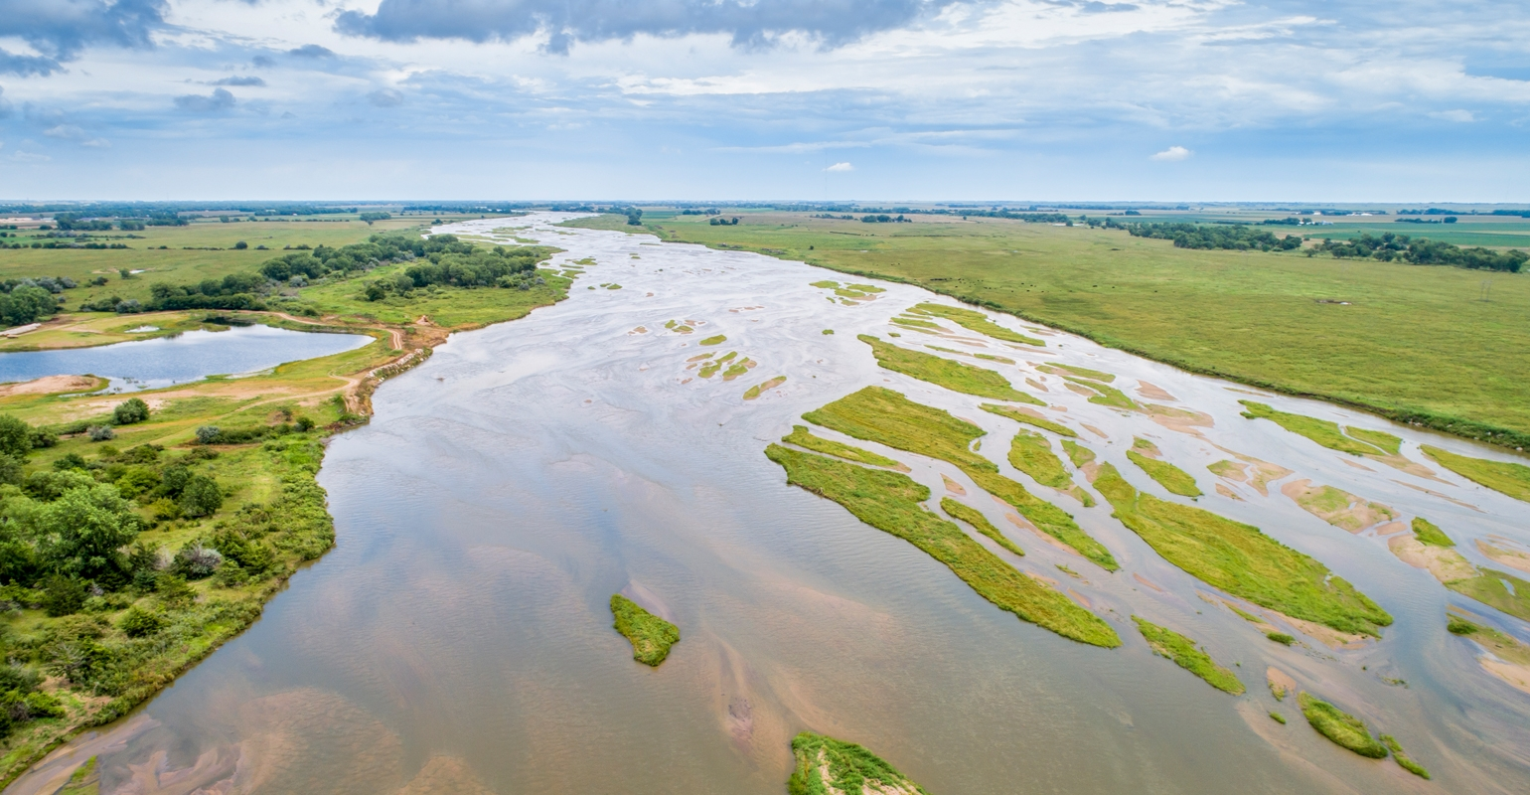
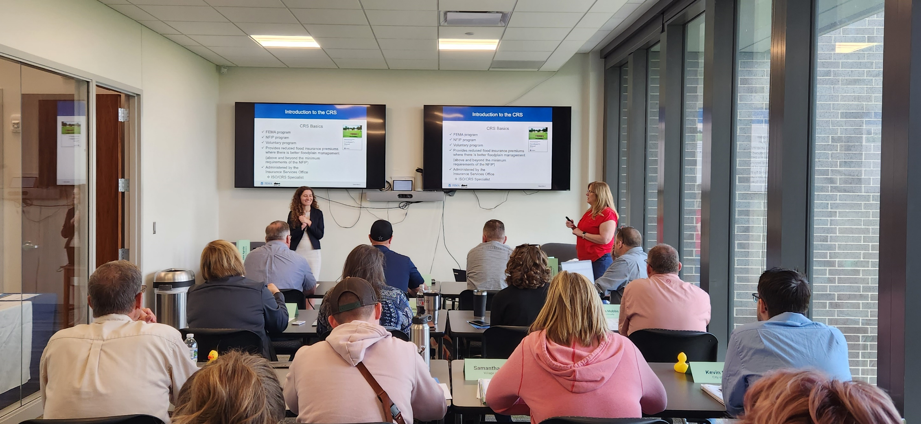
Benefits of Integrated Management
More reliable streamflow’s
Improved and protected aquifer conditions
More efficient use of Federal, State, and local funding
More proactive water planning and management
Improved communication between stakeholders
Increased adaptability to changing conditions
Improved science for decision making
Preserved ability for individual NRDs to manage districts optimally, based on their unique conditions and characteristics
Pooled resources for managing larger geographic areas via Basin Wide Plans
Promoted Voluntary IMP development – initiated by local stakeholders, in addition to IMPs developed in response to NeDNR evaluation
Balanced use of NeDNR and NRD Controls while promoting collaborative, consensus-based decision making
Greater an environment of greater regulatory certainty for our water users

Slide 28
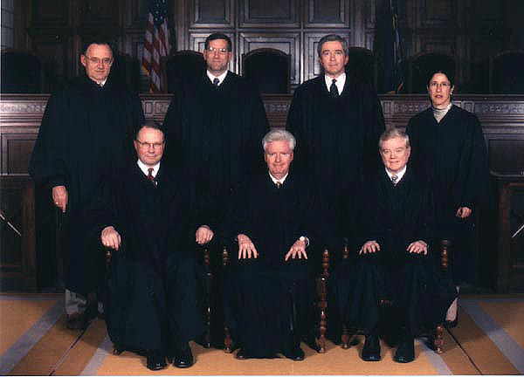
Integrated Management is Held up as Model of Effective Water Management
Subsequent legislation has helped refine and build on improvements enacted through LB 962
Resulted in a proactive, robust framework for integrated water management in Nebraska
Enhanced Cooperation between NRDs and NeDNR
Reduced Litigation
Improved Response to Droughts
Partnerships have been the Key to Success!

Slide 29
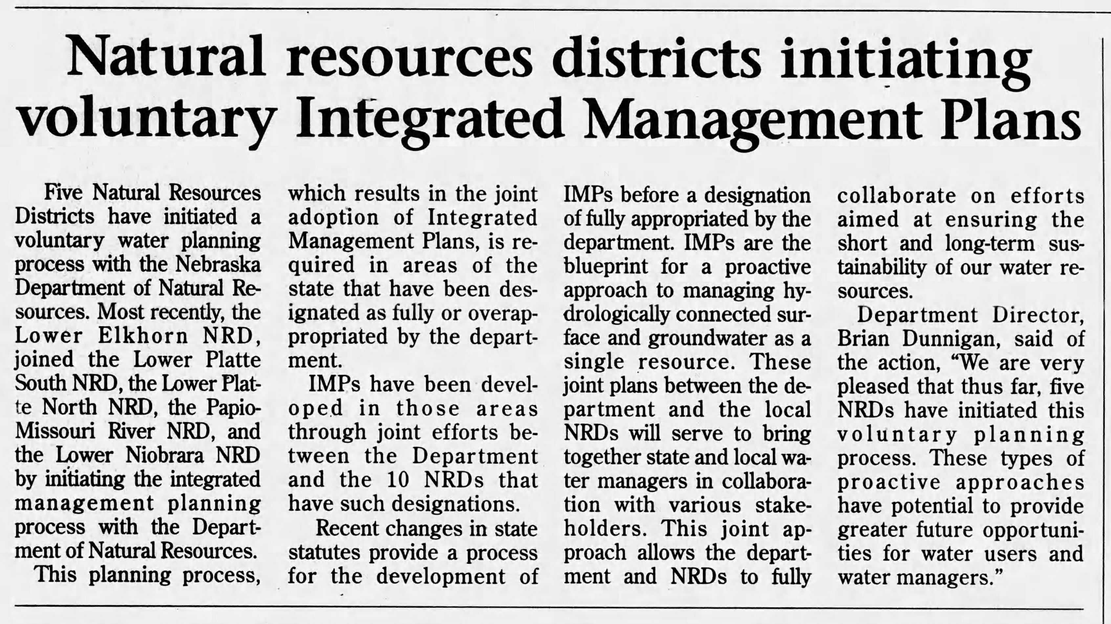
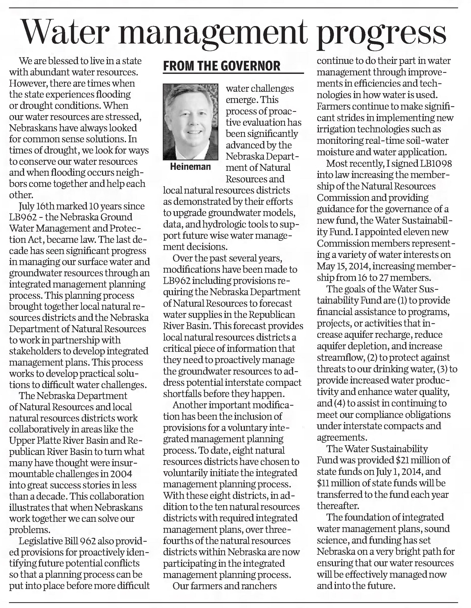
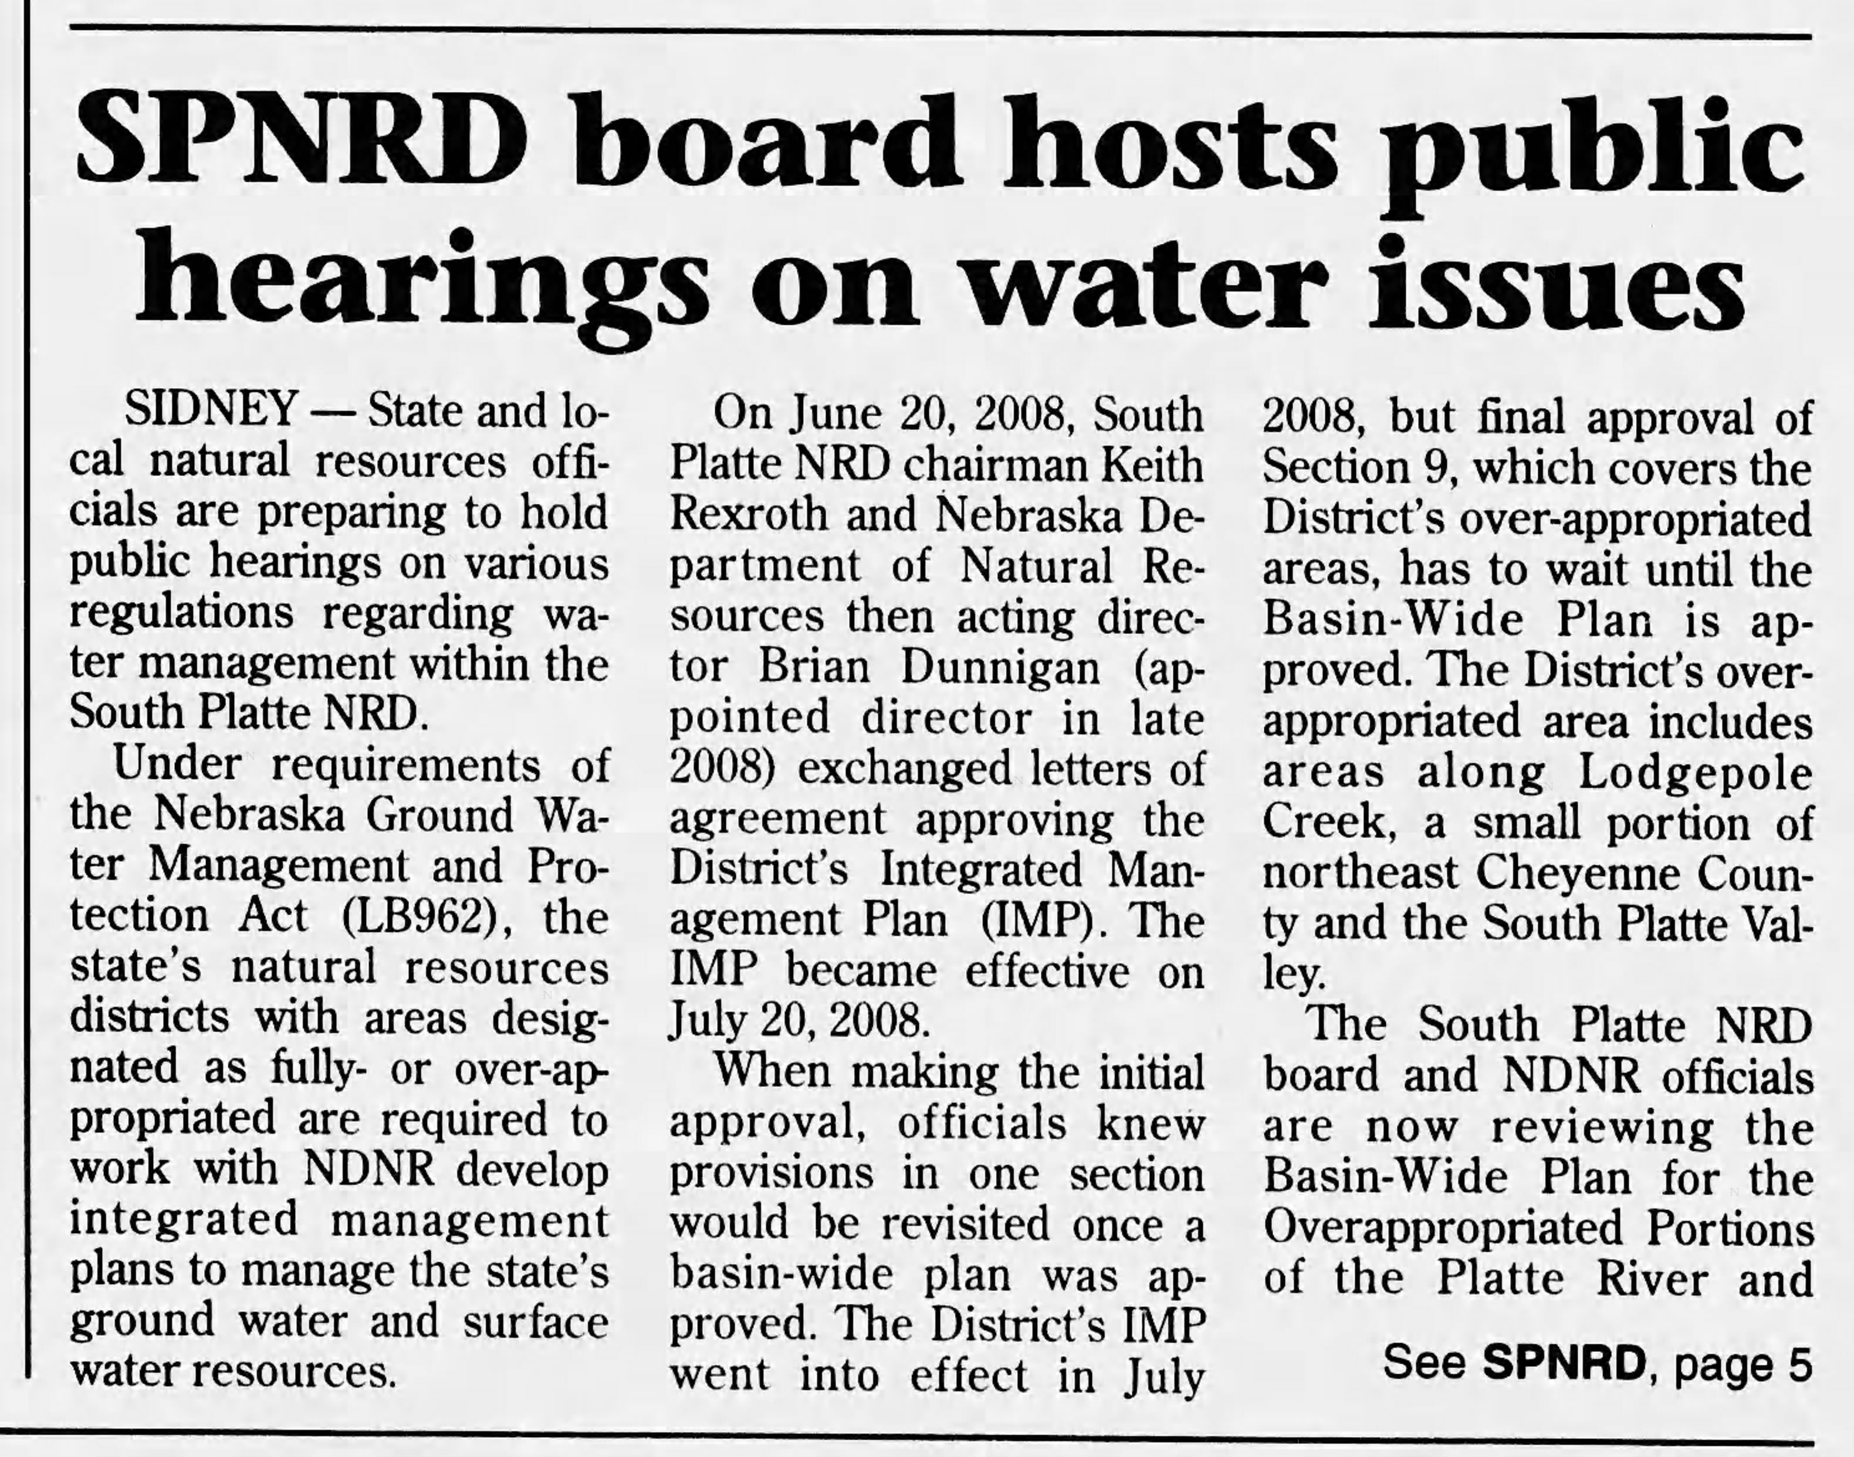
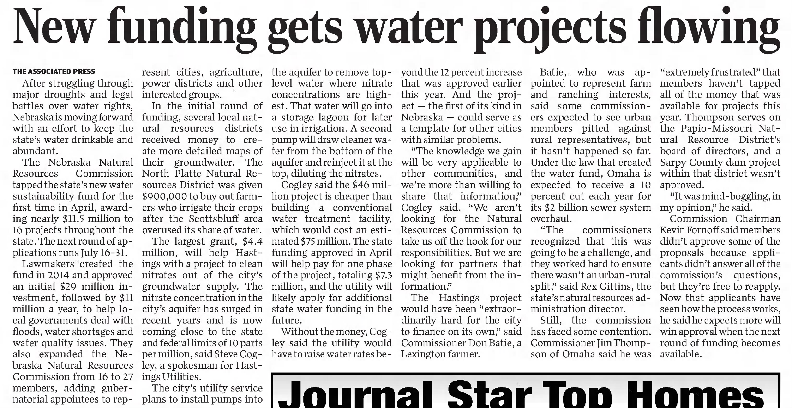
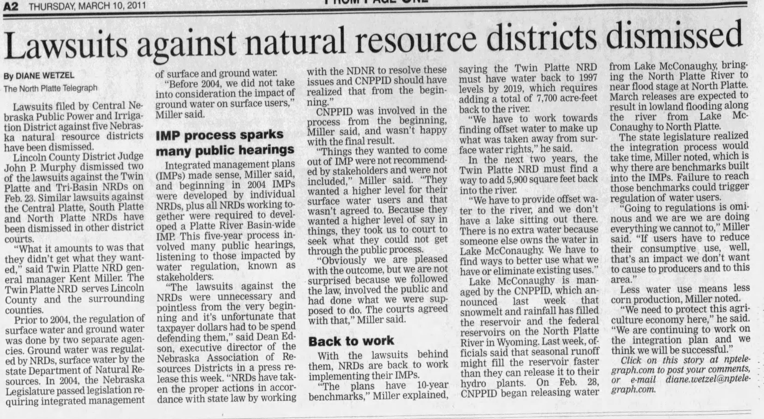
Integrated Management is Held up as Model of Effective Water Management
Subsequent legislation has helped refine and build on improvements enacted through LB 962
Resulted in a proactive, robust framework for integrated water management in Nebraska
Enhanced Cooperation between NRDs and NeDNR
Improved Response to Droughts
Reduced Litigation
Partnerships have been the Key to Success!

Slide 30
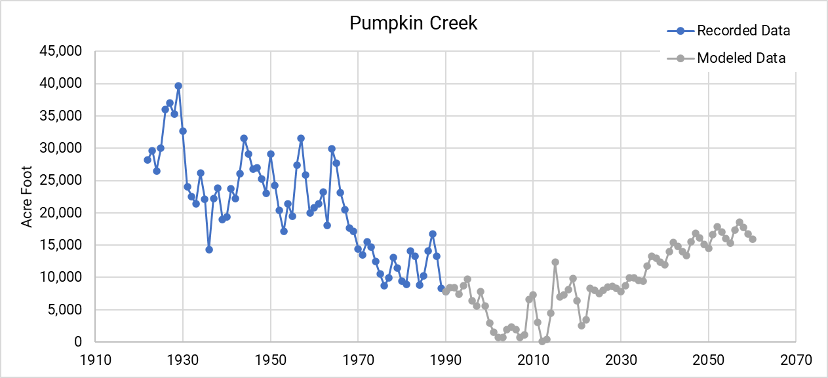
Pumpkin Creek Now

Slide 31
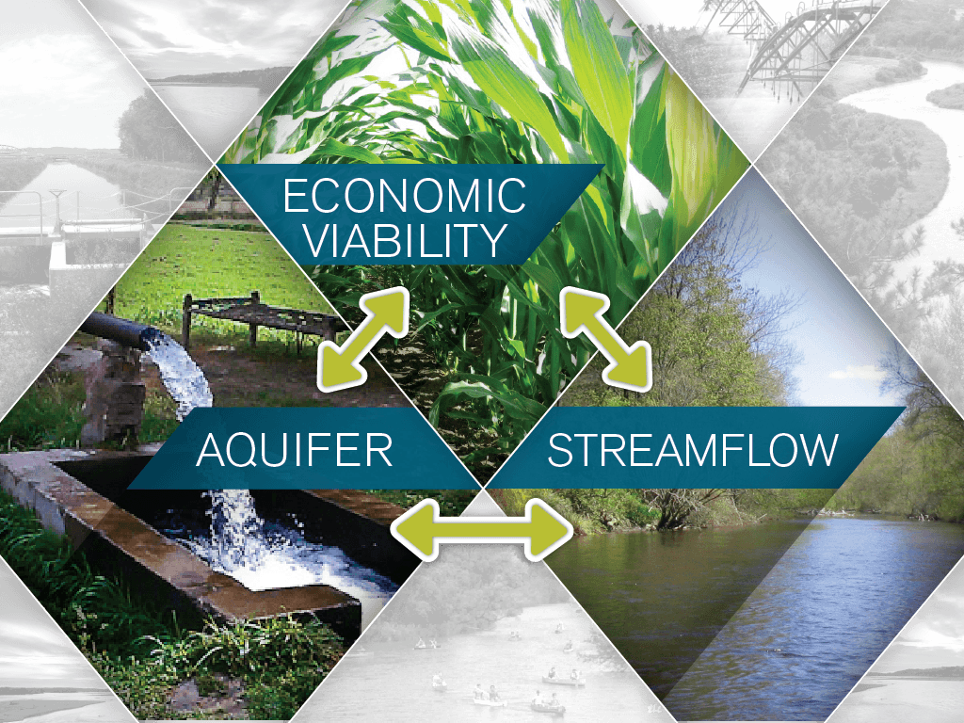
Looking into the Future…
Nebraska needed a way to defend its water future and LB 962 created that framework…
Nebraska is now the envy of the nation and world in how we collaboratively manage our water resources
We need to remain vigilant in areas like the Republican River and Upper Platte River systems
We need to be looking for opportunities to further optimize our water use (technologies for producers, efficiencies, water infrastructure etc.)
We need to continue to look for opportunities to leverage funding resources through other water related programs… soils, water quality, climate resilience
We now have a solid foundation to play offense!

Slide 32
Jesse Bradley, Deputy Director
Jesse.Bradley@nebraska.gov

